Slide 1

Mobile Games: Pay to (Not) Play
Taylor Lundy
Joint work with Narun Raman, Hu Fu, Kevin Leyton-Brown
Notes:
Mobile Games: An Exciting New Domain for Behavioral Game Theory
Kevin Leyton-Brown
Two and a half billion people play mobile games worldwide, spending $180.3B USD in 2021 alone. More than half of this revenue comes from free-to-play mobile games. These games make money through carefully optimized monetization strategies based on optional in-game purchases. Mobile games also often leverage social dynamics to recruit new players and convert existing players into paying customers. Because player behavior in games, while thoughtful, often deviates from standard definitions of rationality, mobile games constitute a rich laboratory for research in behavioural game theory.
In our first work on this topic we looked at the phenomenon of “skips” in which players pay real money to avoid game content. We leverage existing tools of mechanism design to answer questions like “Why would a player ever value skips?” and “Can expensive skips be good for player welfare?”. The talk will focus particularly on open questions from our ongoing work, which investigates elaborating both the behavioral model of player engagement (drawing on recent work from Kleinberg et. al.); incorporating the effects that virality and social networks can have on a game's success; and studying the pervasive monetization scheme in which players are given a handful of “lives” and are forced to wait for a timer to reset these are depleted (or to buy more lives).

Slide 2
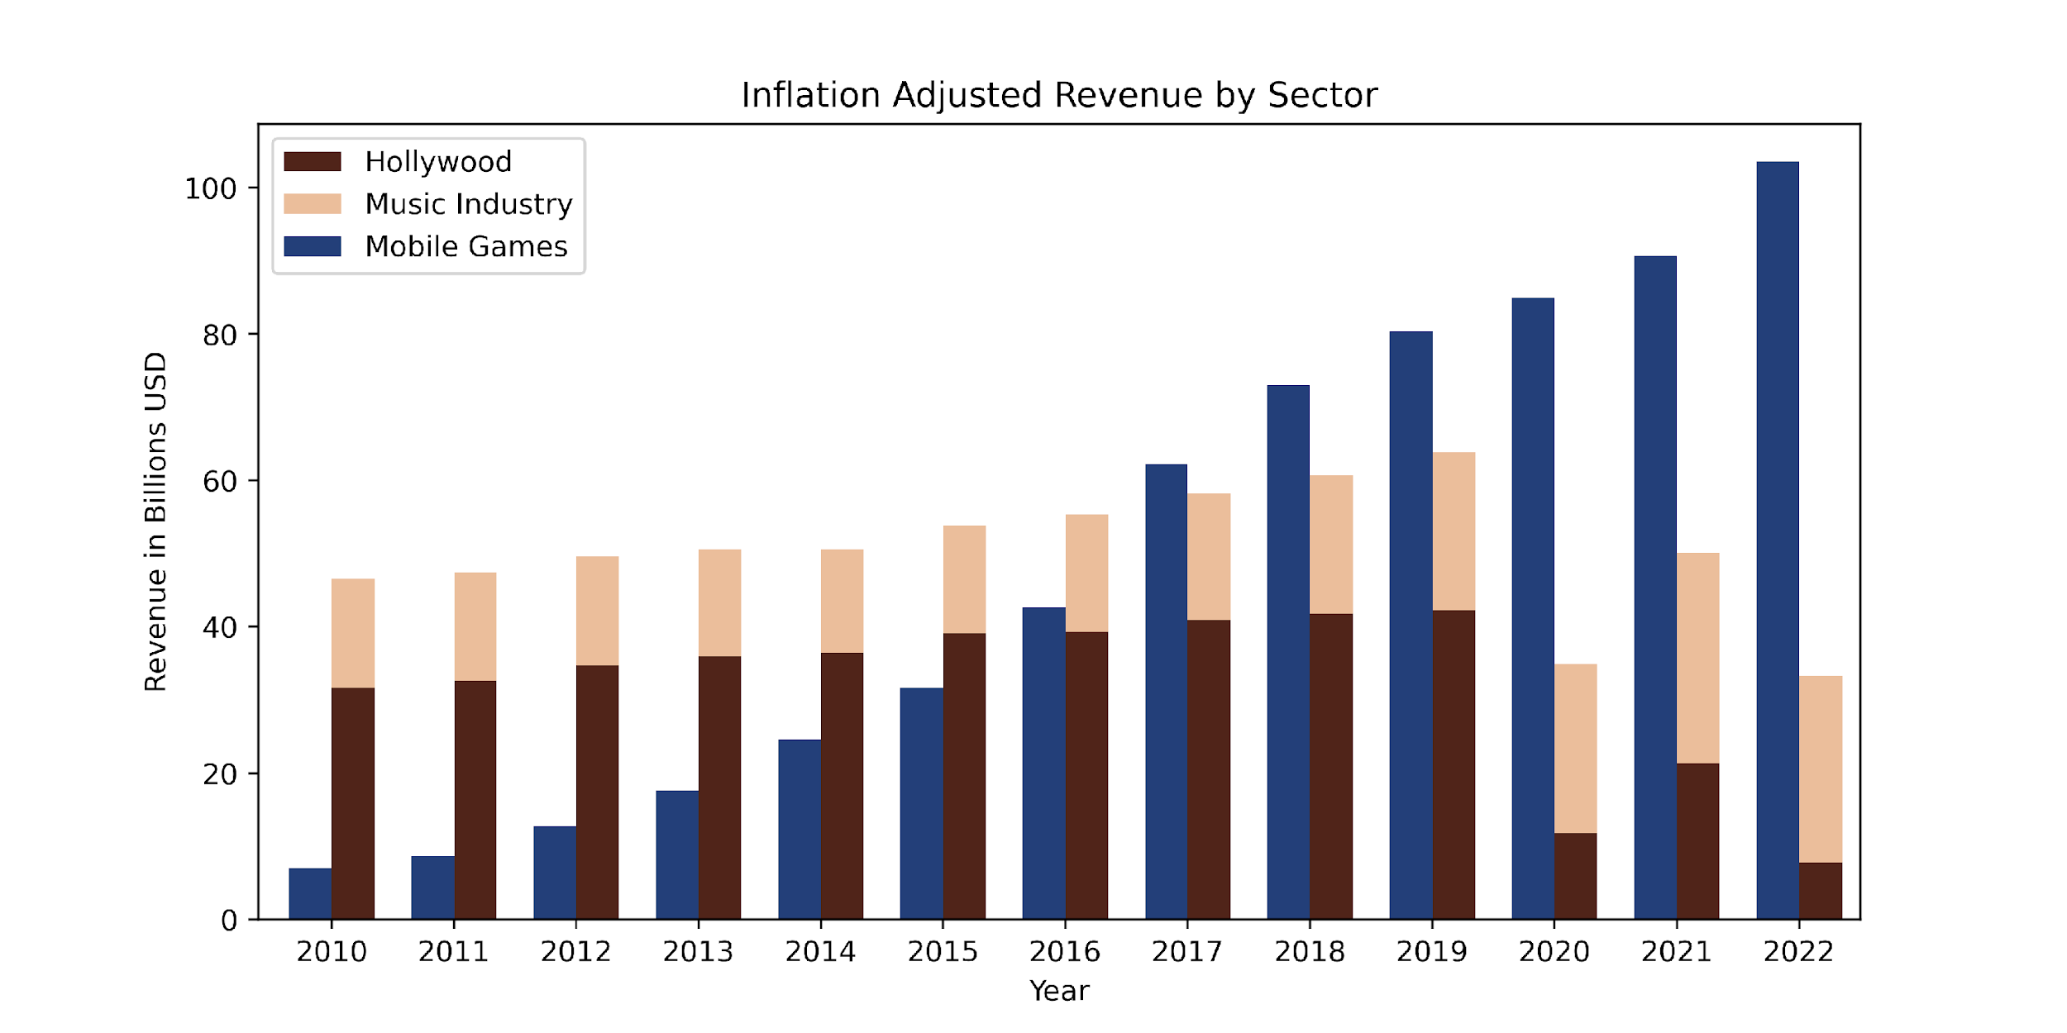


Mobile Gaming is Huge
2.7 billion people worldwide play mobile games
People spend nearly 3 times longer on mobile games than Facebook per day
https://www.the-numbers.com/market/
https://www.statista.com/statistics/272305/global-revenue-of-the-music-industry/
https://www.statista.com/statistics/324267/us-adults-daily-facebook-minutes/
https://www.globenewswire.com/news-release/2022/02/24/2391544/0/en/Over-Two-thirds-of-U-S-Adults-Increase-Time-Spent-Gaming.html
Notes:
Hollywood +music comparison
Anuimate till 2019 and then show pandemic

Slide 3
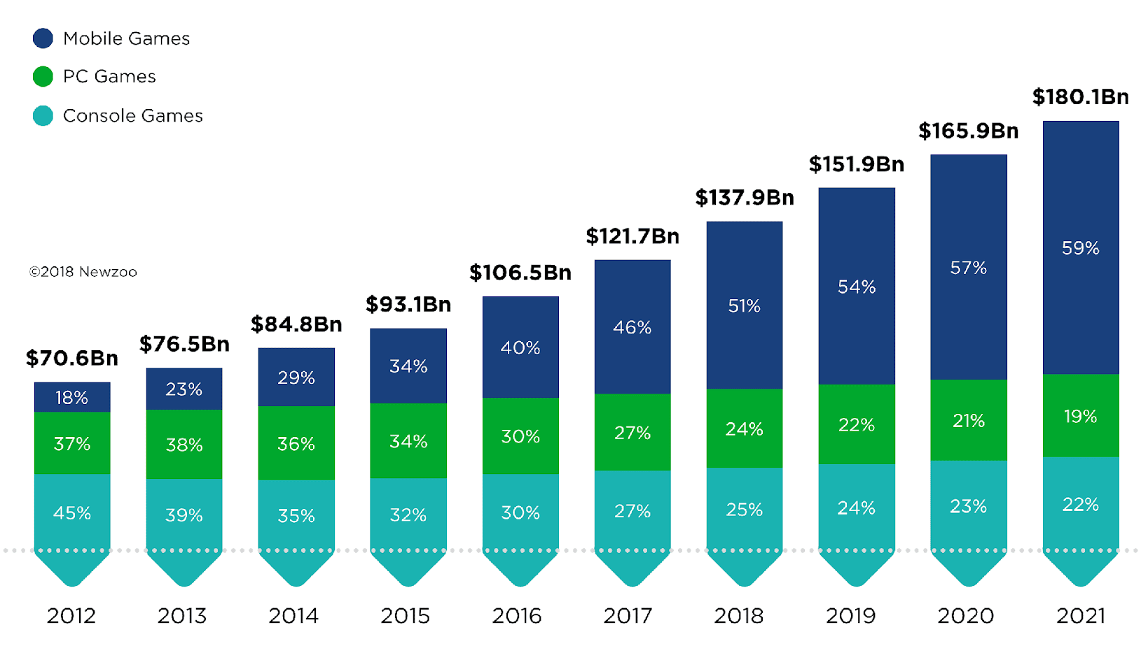

... and Has Quickly Dominated Gaming
2012-2021 Global Gaming Market
$106.3Bn
https://newzoo.com/insights/articles/global-games-market-reaches-137-9-billion-in-2018-mobile-games-take-half
Notes:
More past years.
Growing segment: X fold increase in Y years
Average cost of other games in comparison to free to play. Plotted

Slide 4
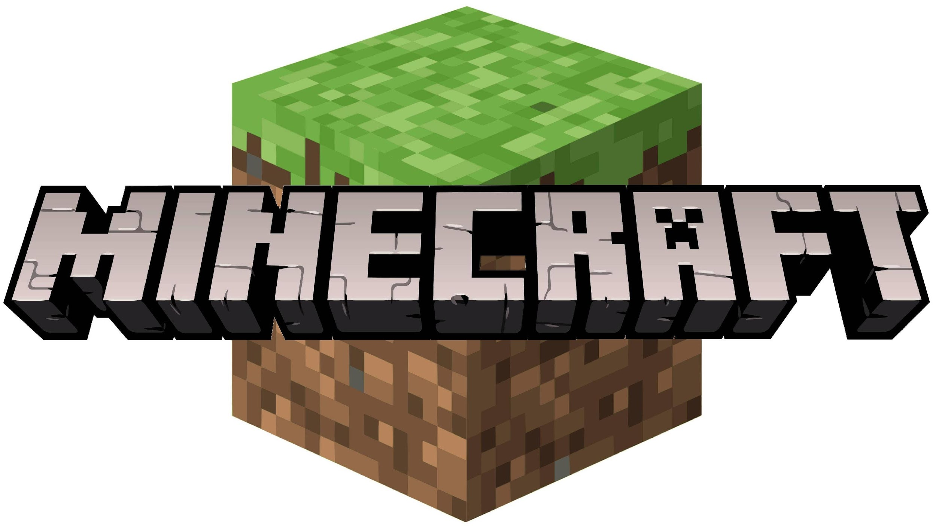

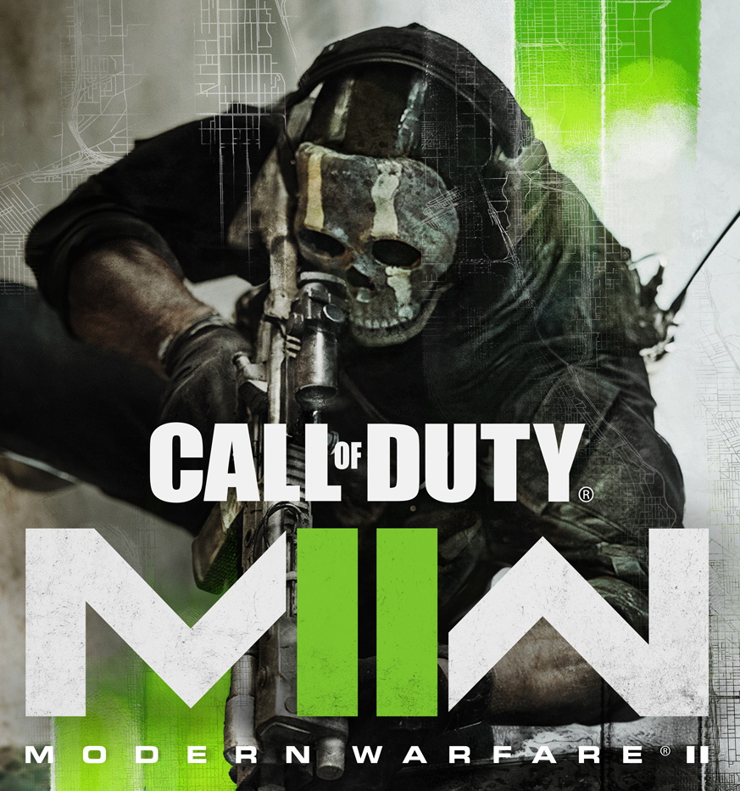
Pricing Model Has Changed
$27
FREE
$70
FREE
$40
80% of mobile games are free to download and start playing!
Notes:
New call of duty game
Animate each piece
Do top grossing games over time

Slide 5

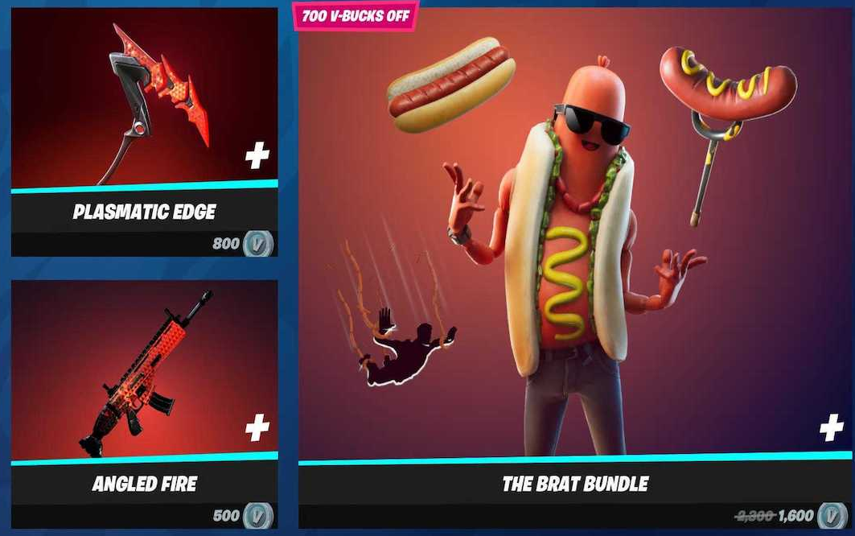
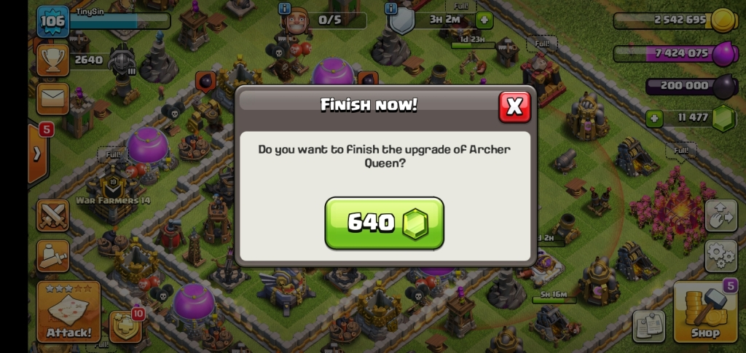
Something New is Going On
Free-to-Play is easily compatible with traditional economic models
  try-before-you-buy
  subscription models
  monetize through ads
The player behaviours mobile games monetize often need new economic models
  virtual items
  buying lives
  paying to avoid waiting
Notes:
Make paying to avoid waiting bold at the end

Slide 6
Something New is Going On
Free-to-Play is easily compatible with traditional economic models
  try-before-you-buy
  subscription models
  monetize through ads
The player behaviours mobile games monetize often need new economic models
  virtual items
  buying lives
  paying to avoid waiting
Notes:
Make paying to avoid waiting bold at the end

Slide 7




Idle Games: Cow Clicker
# of Cows clicked: 1
# of Cows clicked: 2
1 Hr.
2
0 Hrs.
Notes:
Well to get a better glimpse at one of the ways mobile games make money let me tell you about a special class of mobile games called idle games. They are pretty simple so im going to explain them using a running example. Idle games consist of three parts: 1. A task, for example click on this cow, 2. There is a timer (in this example wait 4 hours before you can click another cow) 3. Finally come thing that tracks your accomplishments (cows clicked: 1) that’s better. Now you are probably thinking great another overlysimplistic model that would never work in real life. And to that I say this game is called cow clicker and at its peak had about 50,000 concurrent players. So now we belive this can happen but why? And that’s a great question and the general consensus seems to be that by associating a wait time between tasks it gives its completion some value especially if there are other players around the world also out there clicking on cows.
Now I promised I would talk about how idle games make money and here is my favorite way. So we have a established that players have value for completing clicking the cow because it takes time to complete so what better way to monetize them then to allow them to pay you so that it doesn’t take time in other words let them skip the wait. As it turns out waiting to click on the cow maybe less important than the knowledge that other players might have to wait to click on the cow.
App store page of cow clicker in top right corner

Slide 8
Roadmap
How should we model player value for skips?
  Introduce a model that can explain pricing behaviour in the real-world
  Validate that model
How can we further optimize these prices using tools from mechanism design?

Slide 9



Why On Earth Would Anyone Buy a Skip?
Players value accomplishing tasks others can't [Lehdonvirta 2009]
Players are impatient
These impatience levels are heterogeneous across players
2
1 hr.
$$v$$
density
impatience
Notes:
social value should be emphasized
Be more explicit about the value in difficulty graph
Phrase it both ways.

Slide 10
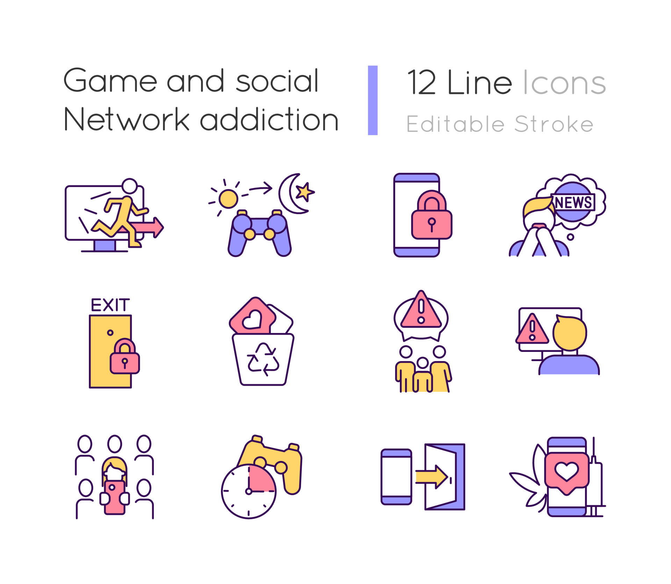

Game Optimization
Game designers claim to be optimizing for player happiness
In practice, skip prices can be very high
Are designers optimizing for revenue instead?
Social 1-Player Game
A happy player base is good for business [Fields & Cotton 2011]
High Churn Rate
Top performing games often report 6.5% retention by day 28
https://gameanalytics.com//blog/key-lessons-boost-game-retention/
Notes:
Now that I've set up the ingredients let me give you the flavor of result we look for. There is seemingly this paradox in the game design community where designers acknowledge that player happiness is the metric the optimize for and yet often we see that skips are prohibitively expensive. How can this make sense. Well the answer lies in something I said earlier. The game retains its value as long as some players are still legitimately completing the task. This leads to an interesting dynamic were the value of the game depends not only on the length of the task but also on the price set to skip it. Even with this ingredient we show that finding distributions of players which can support high prices isn’t easy. We need two things 1. A large portion of the player base who are never willing to buy skips. 2. Enough "whale" players who are willing to spend a lot of money in order to get ahead. What do you know this "whale" distribution is exactly what you would expect to see in a wide range of mobile games.
Conspiscous consumption meninotn it under the first bullet point.
talk about infinite goods
MOVE THIS EARLIER

Slide 11


Skip Prices Affect Values in Two Ways
Cheap skips mean more cows will get clicked. We like accomplishing things others haven’t so value goes down.
Notes:
Impatient players want to receive the value of accomplishing a difficult task without waiting.
But the price of a skip also affects the value of accomplishment

Slide 12



Skip Prices Affect Values in Two Ways
Cheap skips mean cows were more likely clicked by skip buyers. “# of cows clicked” is now a better signal of wealth than dedication
Players are trying to signal how dedicated they are to accomplishing tasks; not how much money is in their wallet, so value goes down
BOOOOO
Notes:
Needs visuals.
Say something about pay to win.

Slide 13

Value Must Depend on How Often Players Believe Skips are Purchased
Players always know their own type but what do they know about others?
Two models of player information:
1. Ex ante
Players don’t know the distribution over impatience for the specific game they are playing
Game designers often have more information about player impatience distribution and actively conceal it from the players
$$v$$
Notes:
Add linear value in scarcity graph here show induced value functions for some distributions.
Talk about why this might be a better model sometimes

Slide 14



Value Must Depend on How Often Players Believe Skips are Purchased
Players always know their own type but what do they know about others?
Two models of player information:
2. Interim
Players know the distribution over impatience for the specific game they are playing
In some games, players might have richer knowledge from outside sources (i.e., online communities, wikis, etc.)
$$v$$
$$v$$
0
$$1−ℙ\left[sale\right]$$
1
Notes:
Add linear value in scarcity graph here show induced value functions for some distributions.
Talk about why this might be a better model sometimes

Slide 15

Different Value Functions Require Different Tools
We focus on two types of value functions:
1
2
$$v$$
$$v$$
Value remains steep until it hits the end
Value function gets flat quickly
Notes:
Add linear value in scarcity graph here show induced value functions for some distributions.
Talk about why this might be a better model sometimes

Slide 16
Settings of Interest
Player Information
Ex Ante
Interim
Value Function
Steep
Flat

Slide 17
Settings of Interest
Player Information
Ex Ante
Interim
Value Function
Steep
Flat

Slide 18
Settings of Interest
Player Information
Ex Ante
Interim
Value Function
Steep
1
2
Flat
3

Slide 19
Settings of Interest
Player Information
Ex Ante
Interim
Value Function
Steep
1
Flat

Slide 20
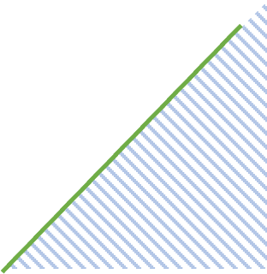

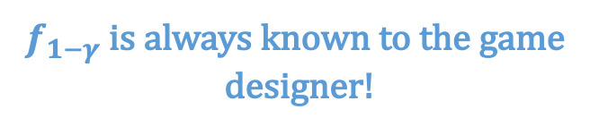
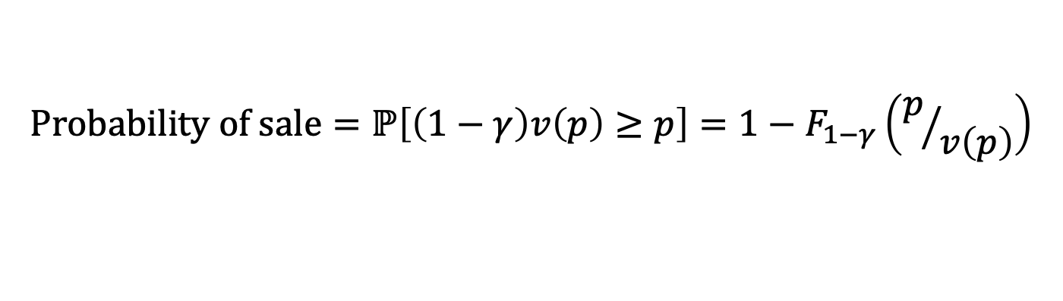


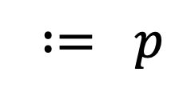
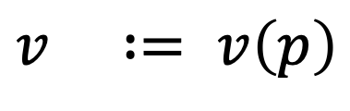
Notation
1
$$\text{impatience}≔1−γ$$
$$v$$
$$∶= p$$
$$\text{density}≔f_{1−γ}$$
density
$$v ∶= v\left(p\right)$$
$$f_{1−γ} \text{is} \text{always} \text{known} \text{to} \text{the} \text{game} \text{designer}\text{!}$$
0
1
impatience
$$\text{Player} i\text{’}\text{s} \text{m}\text{arginal} \text{v}\text{alue} \text{for} \text{a} \text{s}\text{kip} = \left(1−γ_{i}\right)v\left(p\right)$$
$$\text{Probability} \text{of} \text{sale}=ℙ\left[\left(1−γ\right)v\left(p\right)≥p\right]=1−F_{1−γ}\left(p/{v\left(p\right)}\right)$$
Notes:
social value should be emphasized
Be more explicit about the value in difficulty graph
Phrase it both ways.

Slide 21
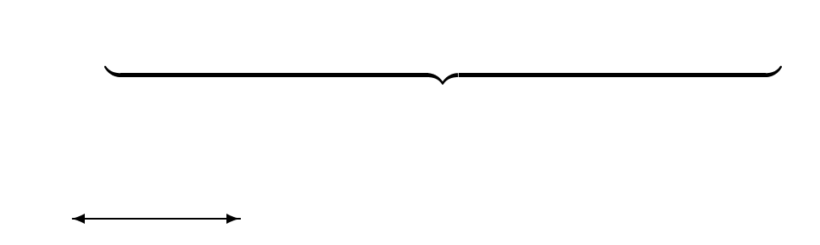
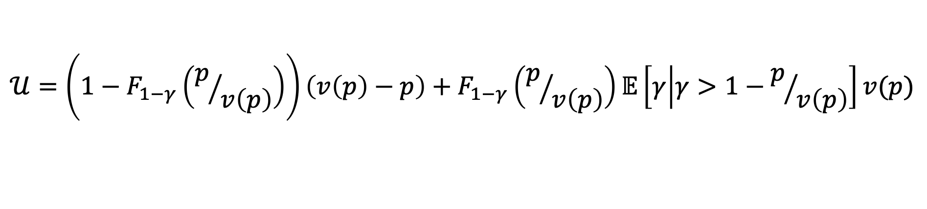
What Does Social Utility Look Like?
1
$$𝒰=\left(1−F_{1−γ}\left(p/{v\left(p\right)}\right)\right)\left(v\left(p\right)−p\right)+F_{1−γ}\left(p/{v\left(p\right)}\right)𝔼\left[γ | γ>1−p/{v\left(p\right)}\right]v(p)$$
Buyers
Non-Buyers
Notes:
Describe some notation and the formula for utility

Slide 22

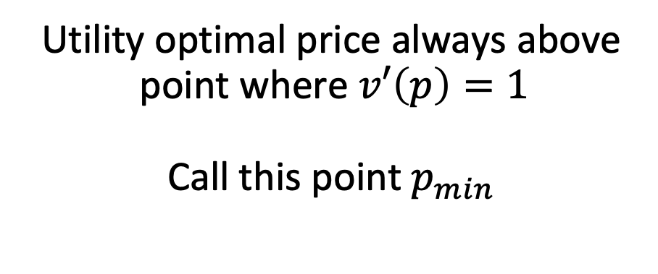
Useful Fact
1
Utility optimal price always above point where $v′\left(p\right)=1$
Call this point $p_{min}$
$$v$$
Notes:
social value should be emphasized
Be more explicit about the value in difficulty graph
Phrase it both ways.

Slide 23
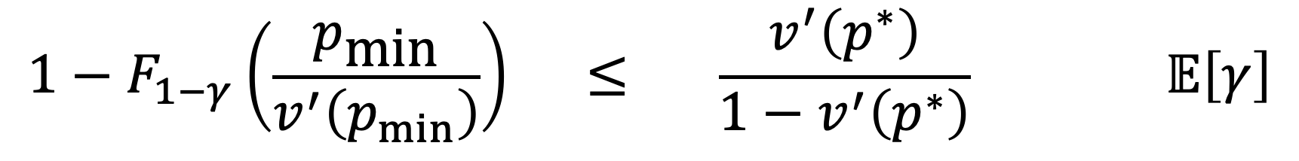
When are Players Happiest with Expensive Skips?
1
$𝒰_{\text{max}} \text{sets} p^{∗}>\text{0, }\text{such} \text{that} v(p^{∗})=p^{∗} \text{when}$
$$1−F_{1−γ}\left(\frac{p_{\text{min}}}{v^{′}\left(p_{min}\right)}\right) ≤ \frac{v^{′}\left(p^{∗}\right)}{1−v^{′}\left(p^{∗}\right)} 𝔼\left[γ\right]$$
Portion of players who would ever purchase a skip at a “reasonable” price
How much is value still increasing as we reach zero probability of sale
How patient is the population of players?
Notes:
This will mostly be graphs with the text
Should state the result not just the equation

Slide 24
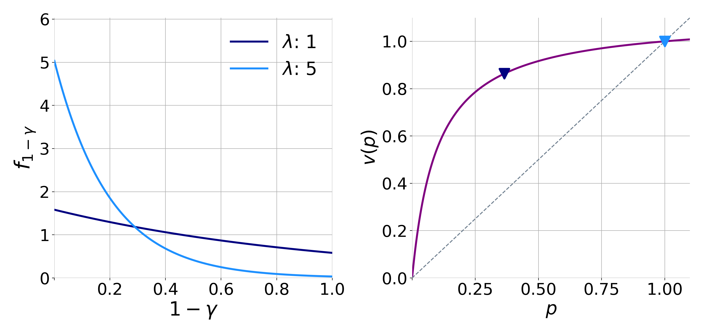
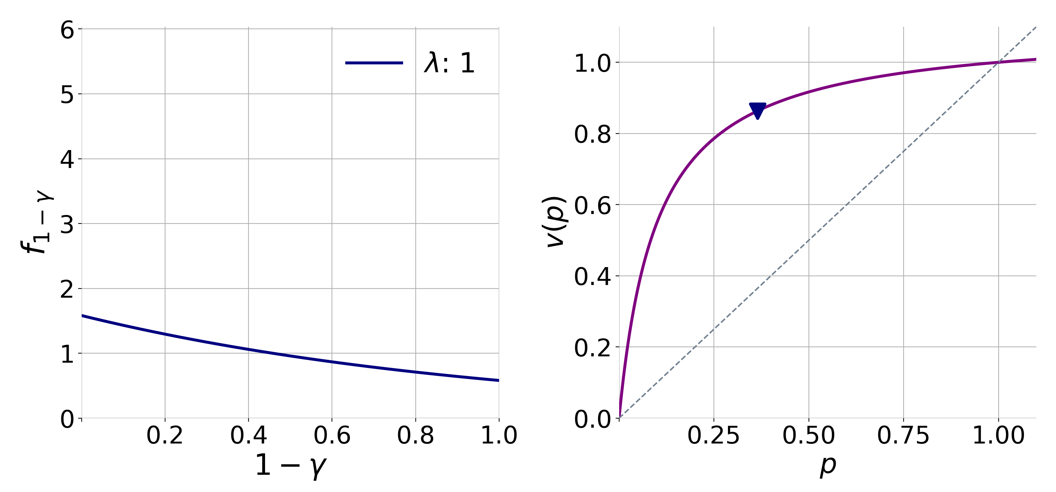

When are Players Happiest with Expensive Skips?
1
Truncated Exponential Distribution
$$v\left(p\right)=1−{\left(p−1\right)}^{4}$$
Notes:
Graphs here

Slide 25
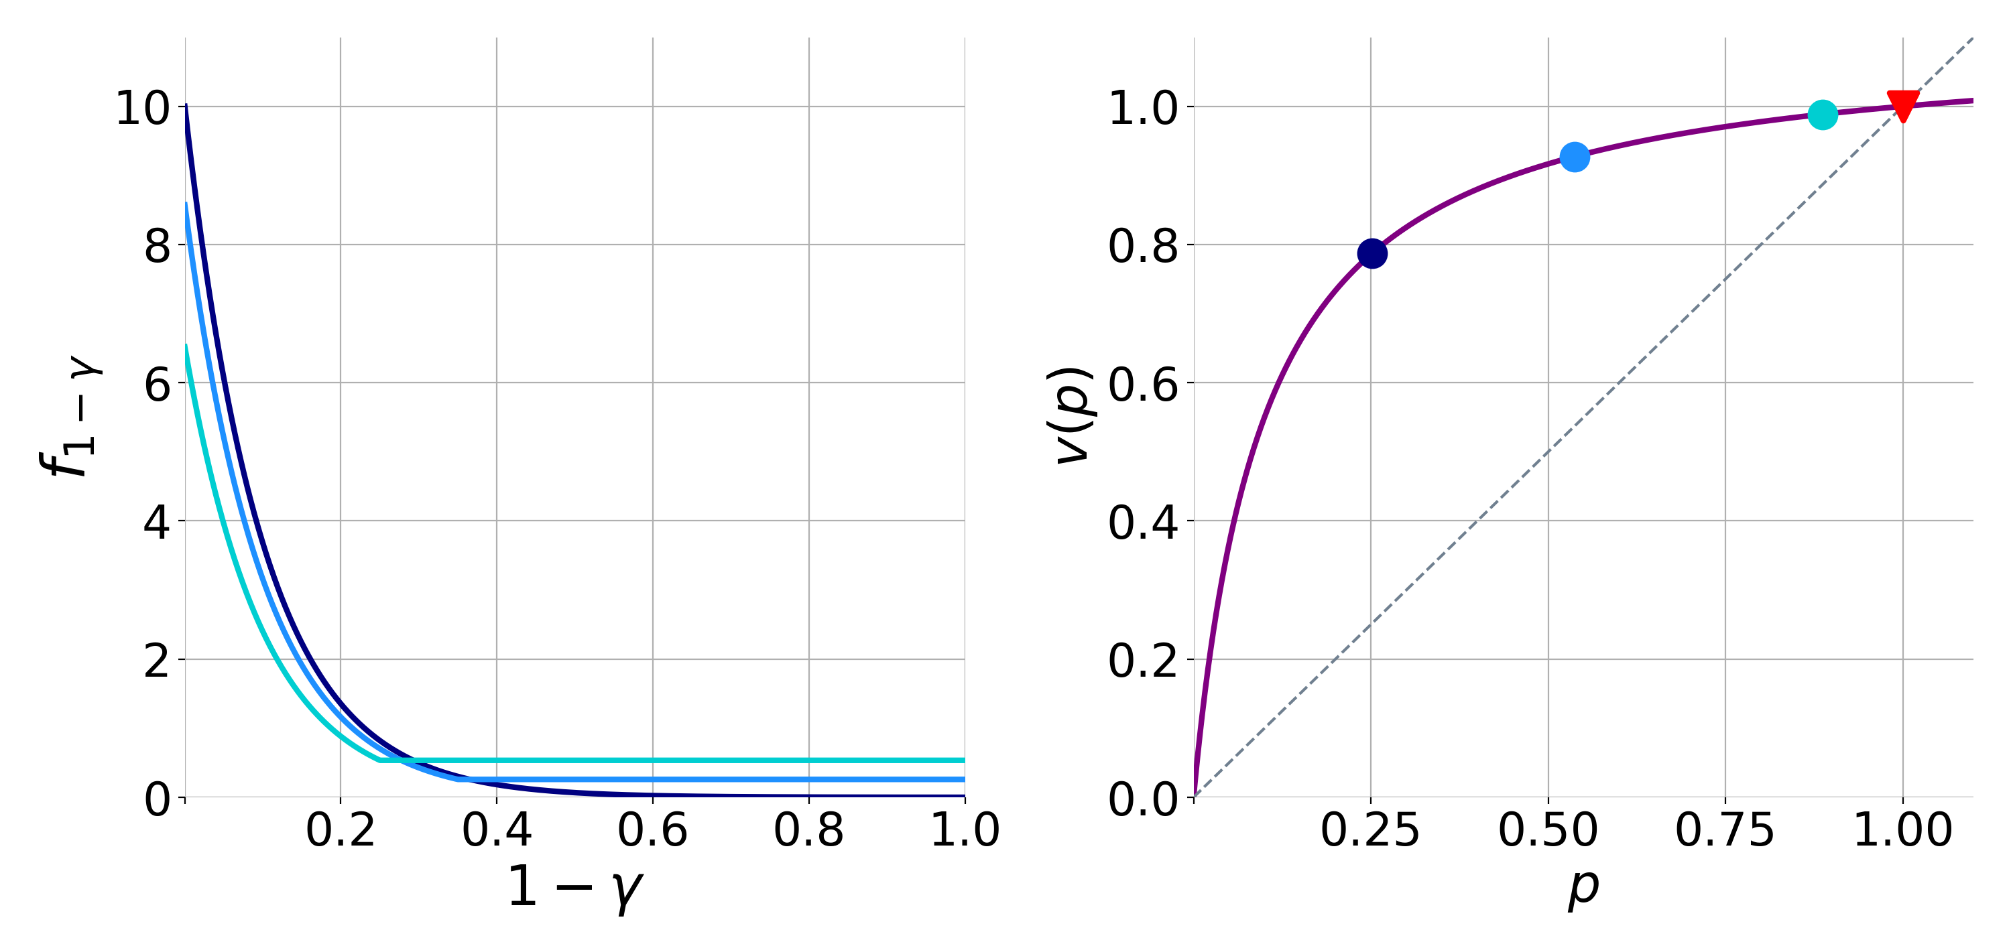
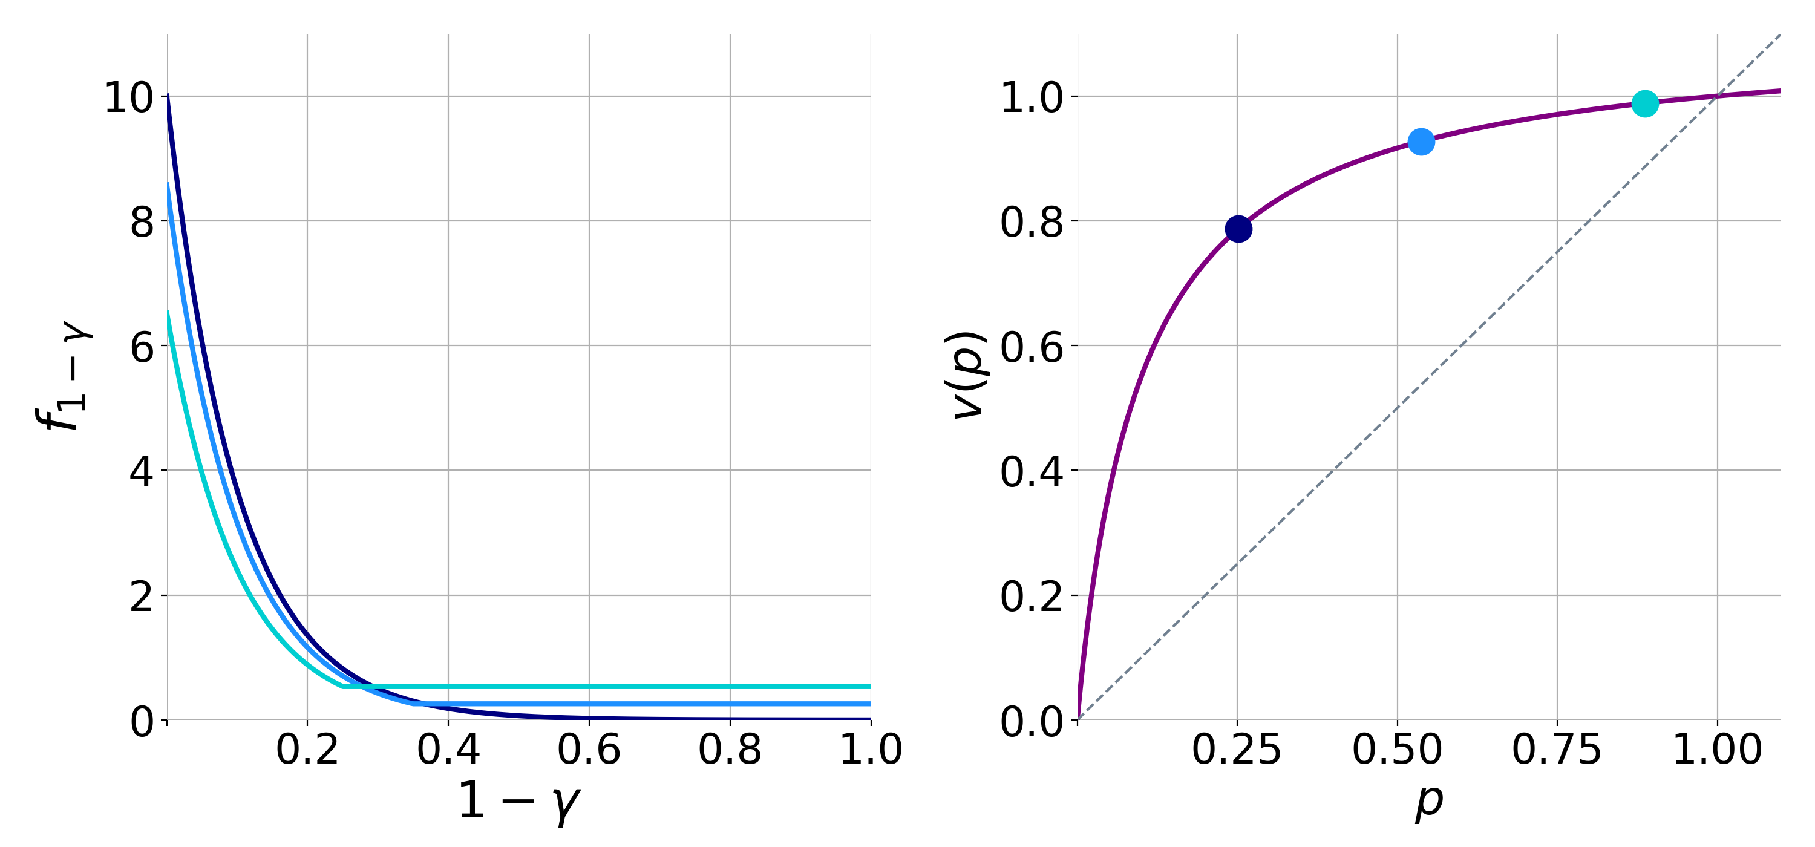
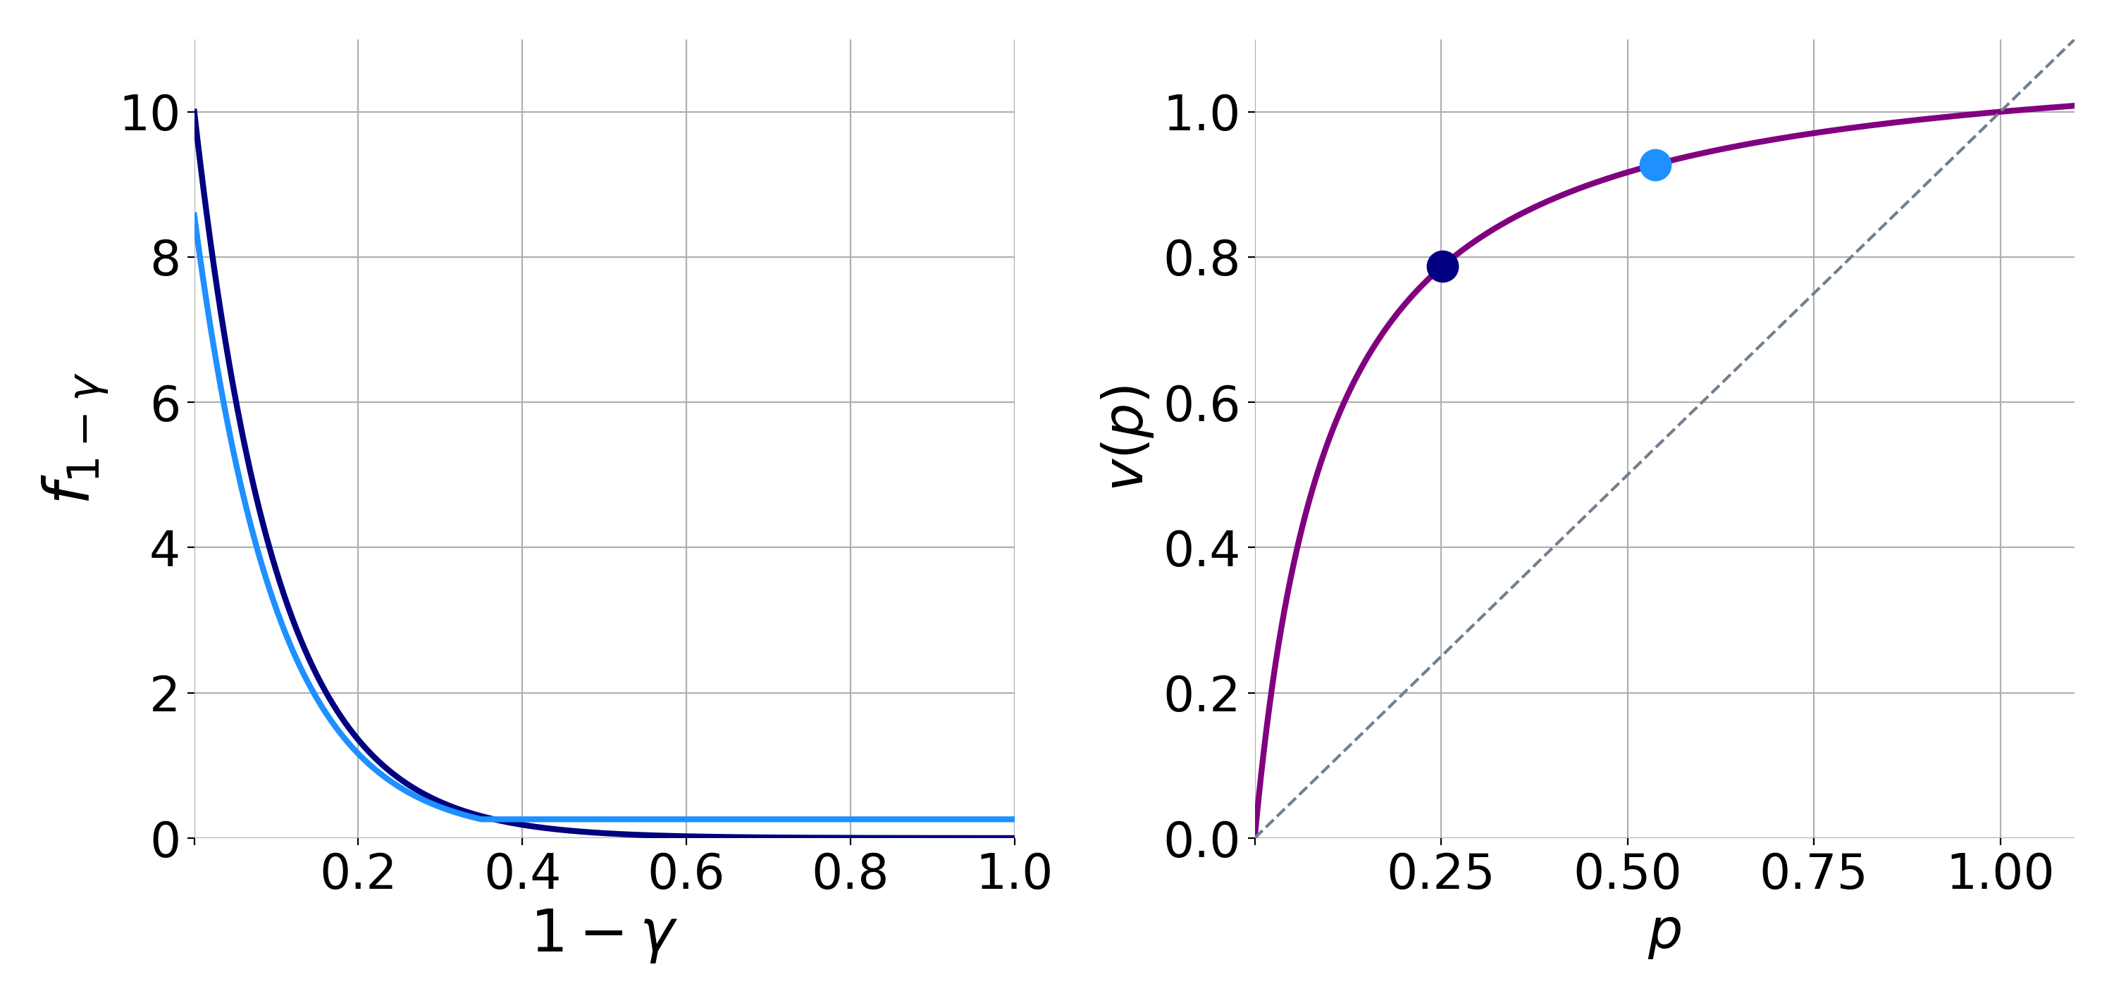
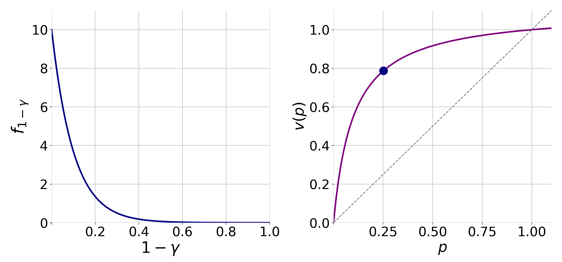





What About Revenue?
1
Truncated Exponential Distribution
$$𝒰_{\text{max}}$$
$$λ=10$$
$$v\left(p\right)=1−{\left(p−1\right)}^{4}$$
$$τ=0.25$$
$$τ=0.35$$
Notes:
Revenue result here maybe definitely the graphs

Slide 26




Evidence from Practice
1
Top Grossing Idle Games
 | Average Revenue Per User | Average Revenue Per Paying User | Buyer Rate
1 | $1.52 USD | $29.43 USD | 5.1%
2 | $0.79 USD | $20.32 USD | 3.9%
3 | $0.68 USD | $79.96 USD | 1.8%
4 | $0.63 USD | $27.40 USD | 2.3%
5 | $0.51 USD | $33.99 USD | 4.9%
75% of Kongregate’s revenue comes from just 2.1% of players
1. Don't Call Them Whales: Free-to-Play Spenders & Virtual Value GDC 2021
2. https://blog.kongregate.com/the-rise-and-rise-of-idle-games/
Notes:
Now that I've set up the ingredients let me give you the flavor of result we look for. There is seemingly this paradox in the game design community where designers acknowledge that player happiness is the metric the optimize for and yet often we see that skips are prohibitively expensive. How can this make sense. Well the answer lies in something I said earlier. The game retains its value as long as some players are still legitimately completing the task. This leads to an interesting dynamic were the value of the game depends not only on the length of the task but also on the price set to skip it. Even with this ingredient we show that finding distributions of players which can support high prices isn’t easy. We need two things 1. A large portion of the player base who are never willing to buy skips. 2. Enough "whale" players who are willing to spend a lot of money in order to get ahead. What do you know this "whale" distribution is exactly what you would expect to see in a wide range of mobile games.

Slide 27
Settings of Interest
Player Information
Ex Ante
Interim
Value Function
Steep
2
Flat

Slide 28
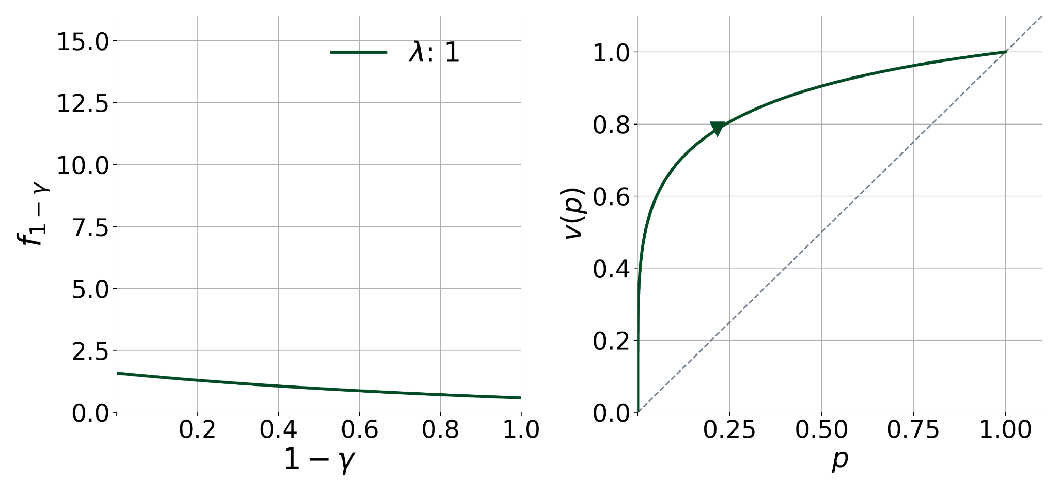
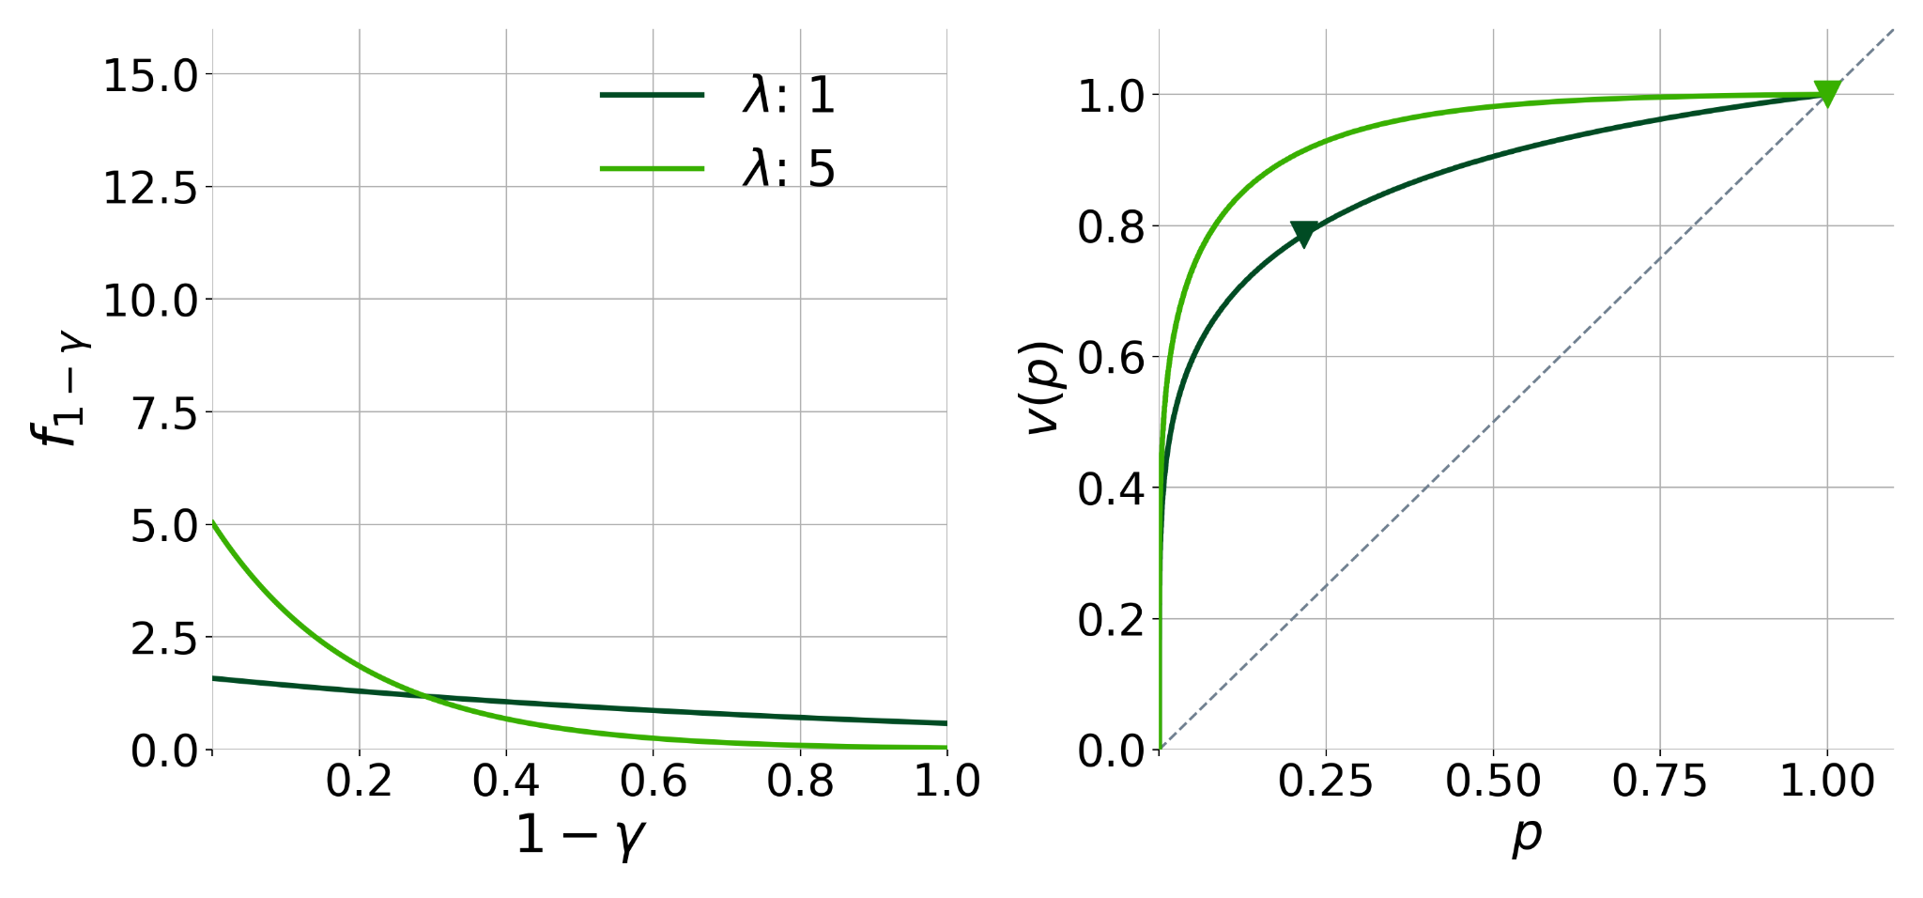
What About the Interim Model?
2
For a while we see the same effect as before
Truncated Exponential Distribution
Notes:
First we see that for quite a while the trend we saw from before holds. We add more patient people without perturnig the tail too much and people are generally happier but something strange happens if we take this too far, the utility optimal price starts to go back down. Whats the reason the for this? Essentially the non-buying players become satisfied pretty quickly. Even a low price makes it so the are very few cheater and there isnt a ton to gain by making it higher. However for those few people purchasing skips their utility is hurt a lot by raising the price up further.
I wont spend too much time on the revenue case but its similar thicker tails drive the prices up but its a bit harder to have both revenue and utility be super high.
pr sale graphs animated

Slide 29
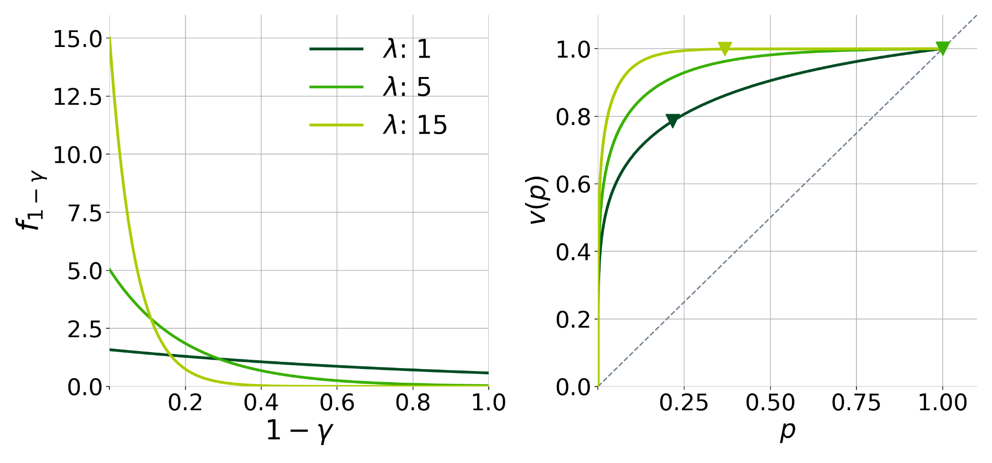
What About the Interim Model?
2
When things get too extreme the trend flips
Truncated Exponential Distribution
Notes:
First we see that for quite a while the trend we saw from before holds. We add more patient people without perturnig the tail too much and people are generally happier but something strange happens if we take this too far, the utility optimal price starts to go back down. Whats the reason the for this? Essentially the non-buying players become satisfied pretty quickly. Even a low price makes it so the are very few cheater and there isnt a ton to gain by making it higher. However for those few people purchasing skips their utility is hurt a lot by raising the price up further.
I wont spend too much time on the revenue case but its similar thicker tails drive the prices up but its a bit harder to have both revenue and utility be super high.
pr sale graphs animated

Slide 30
Settings of Interest
Player Information
Ex Ante
Interim
Value Function
Steep
Flat
3

Slide 31
Let’s Focus on Buyers
3
1.0
0.8
0.6
0.4
0.2
0.25
0.50
0.75
1.00
Notes:
Animated slide that zooms in on the flat region.

Slide 32
Let’s Focus on Buyers
3
1.0
0.8
0.6
0.4
0.2
0.50
0.75
1.00
Notes:
Animated slide that zooms in on the flat region.

Slide 33
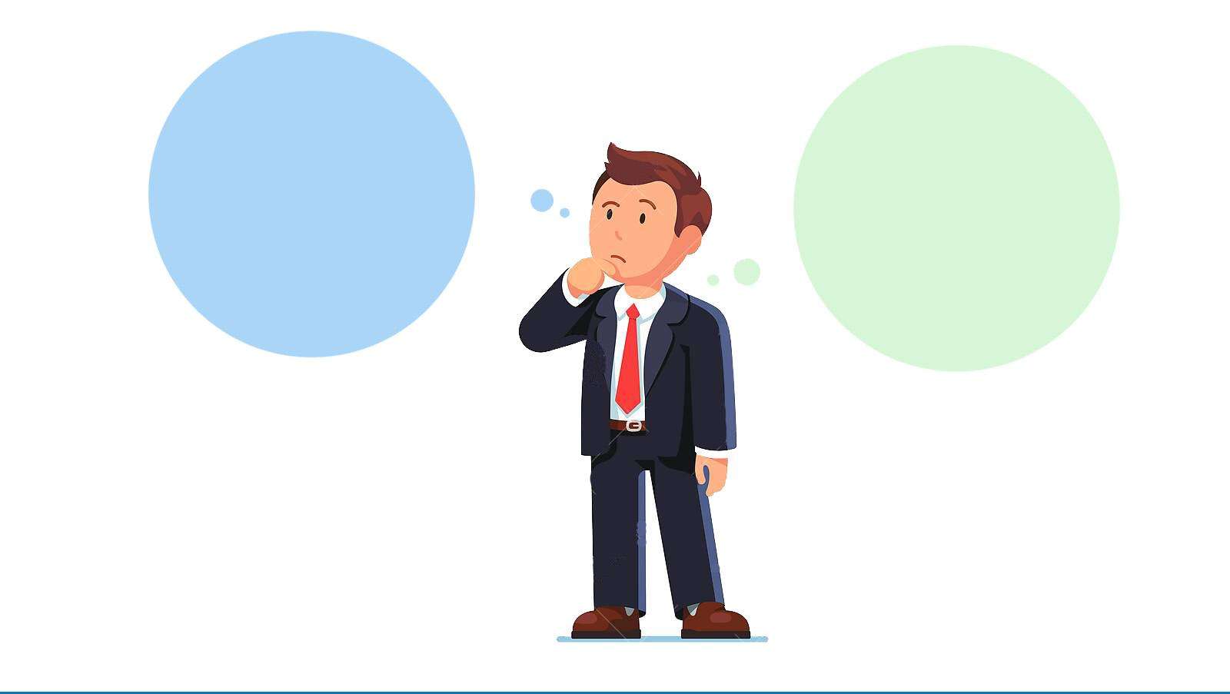



How Should we Balance Utility and Revenue?
3
Explicitly model the trade-off by having retention (probability players stay in the game) depend on the utility they achieve.
At every round, each player $i$draws some outside option $r$ where $F_{r}\left(util_{i}\right)$ describes their retention probability
Notes:
Do visuals that we discussed (candy crush vs garden scapes)
afterwards show Revenue equation on this slide
Say retention is resampled and that types are not

Slide 34
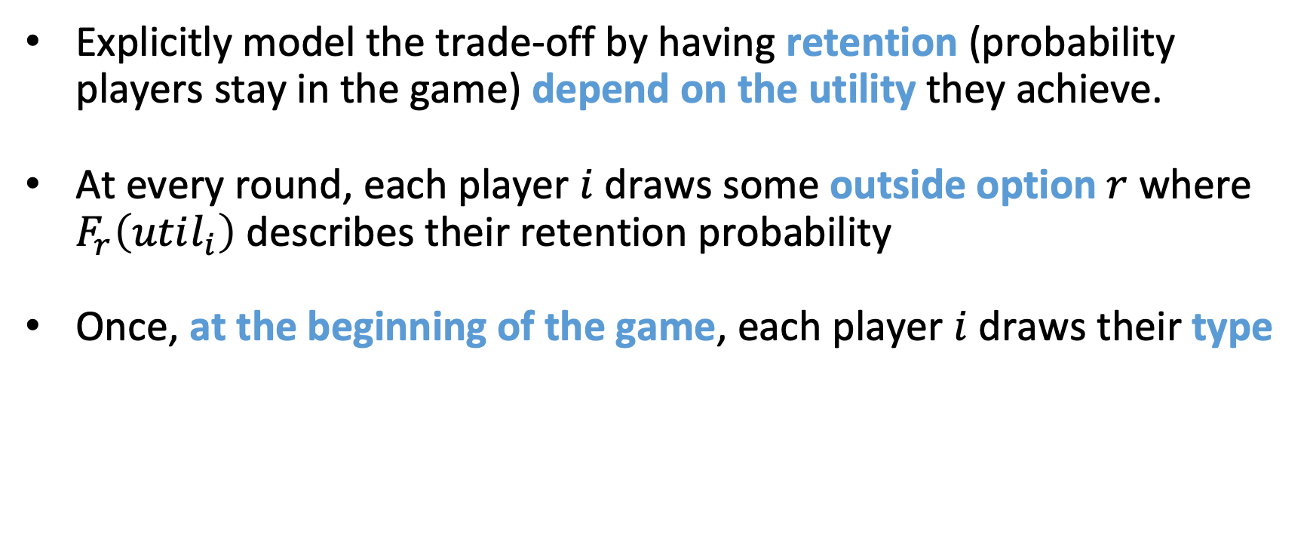
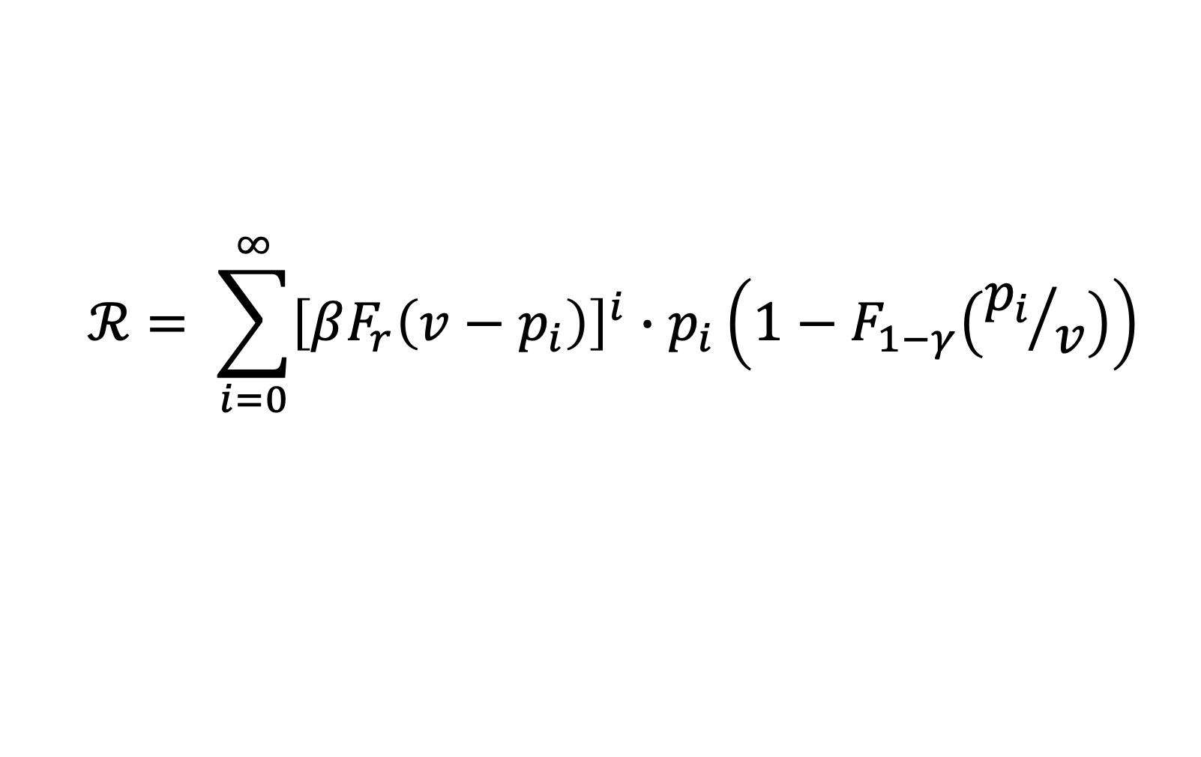
How Should we Balance Utility and Revenue?
3 + MHR
Explicitly model the trade-off by having retention (probability players stay in the game) depend on the utility they achieve.
At every round, each player $i$draws some outside option $r$ where $F_{r}\left(util_{i}\right)$ describes their retention probability
Once, at the beginning of the game, each player $i$ draws their type
$$ℛ= \sum_{i=0}^{∞}{{\left[βF_{r}\left(v−p_{i}\right)\right]}^{i}∙p_{i}\left(1−F_{1−γ}\left({p_{i}}/v\right)\right)}$$
Notes:
Do visuals that we discussed (candy crush vs garden scapes)
afterwards show Revenue equation on this slide
Say retention is resampled and that types are not

Slide 35
Optimal Pricing
3 + MHR
We could try to optimize the sequence of prices directly, but this doesn’t give us a lot of insight
Is there something simpler that achieves a constant fraction of the same performance?

Slide 36




Insight from a Designer with Oracle Access to Types
3 + MHR
Game designer can set different prices for each type
Single Round Revenue
Probability Retained
$$ℛ_{k}$$
$$F_{r}(util)$$
$$p$$
$$p$$
In one round, revenue is exactly price
BUT
probability they stay in the game decreases

Slide 37






Insight from a Designer with Oracle Access to Types
3 + MHR
Game designer can set different prices for each type
$$ℛ_{k}$$
$$F_{r}(util)$$
$$p$$
$$p$$
$$ℛ$$
$$p hello$$

Slide 38

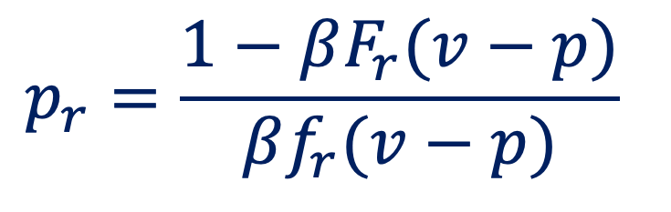
Insight from a Designer with Oracle Access to Types
3 + MHR
$$ℛ_{k}$$
$$F_{r}(util)$$
$$p_{r}=\frac{1−βF_{r}(v−p)}{βf_{r}(v−p)}$$
$$p$$
$$p$$
$$ℛ$$
$$p$$

Slide 39

Insight from a Designer with Oracle Access to Types
3 + MHR
Charge the minimum of a player’s marginal value and $p_{r}$
$$ℛ_{k}$$
$$F_{r}(util)$$
$$p_{r}=\frac{1−βF_{r}(v−p)}{βf_{r}(v−p)}$$
$$p$$
$$p$$
$$ℛ$$
$$\left(1−γ_{i}\right)v$$
$$p$$

Slide 40
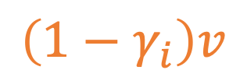

Insight from a Designer with Oracle Access to Types
3 + MHR
Charge the minimum of a player’s marginal value and $p_{r}$
$$ℛ_{k}$$
$$F_{r}(util)$$
$$p_{r}=\frac{1−βF_{r}(v−p)}{βf_{r}(v−p)}$$
$$p$$
$$p$$
$$ℛ$$
$$\left(1−γ_{i}\right)v$$
$$p$$

Slide 41
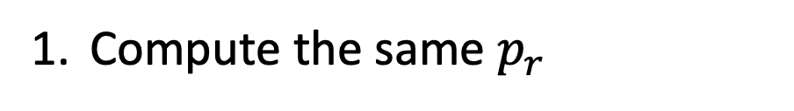
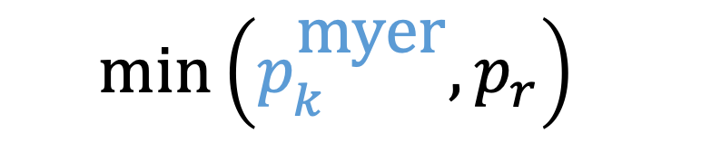
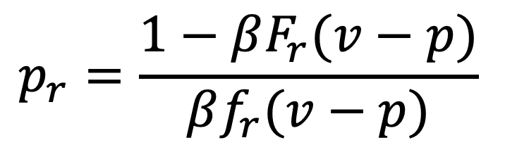
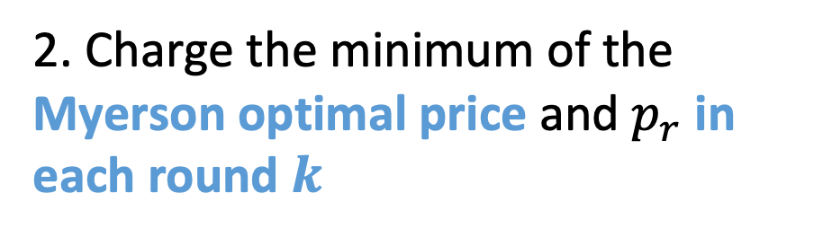
A Good, Simple Pricing Scheme: MT Pricing
3 + MHR
MT pricing achieves a 1/e fraction of the optimal revenue
Compute the same $p_{r}$
2. Charge the minimum of the Myerson optimal price and $p_{r}$ in each round $k$
$$p_{r}=\frac{1−βF_{r}(v−p)}{βf_{r}(v−p)}$$
$$m\text{in}\left(p_{k}^{\text{myer}}, p_{r}\right)$$
Notes:
Insert upper bound from the paper on this slide
Insert Min(marginal value, Upper Bound)

Slide 42
Simulations
3 + MHR
One might worry the upper bound is saving you from some theoretical worst case, but the approximation is not good on average
We simulate a variety of possible type and retention distributions to understand where the performance gains of MT pricing occur

Slide 43
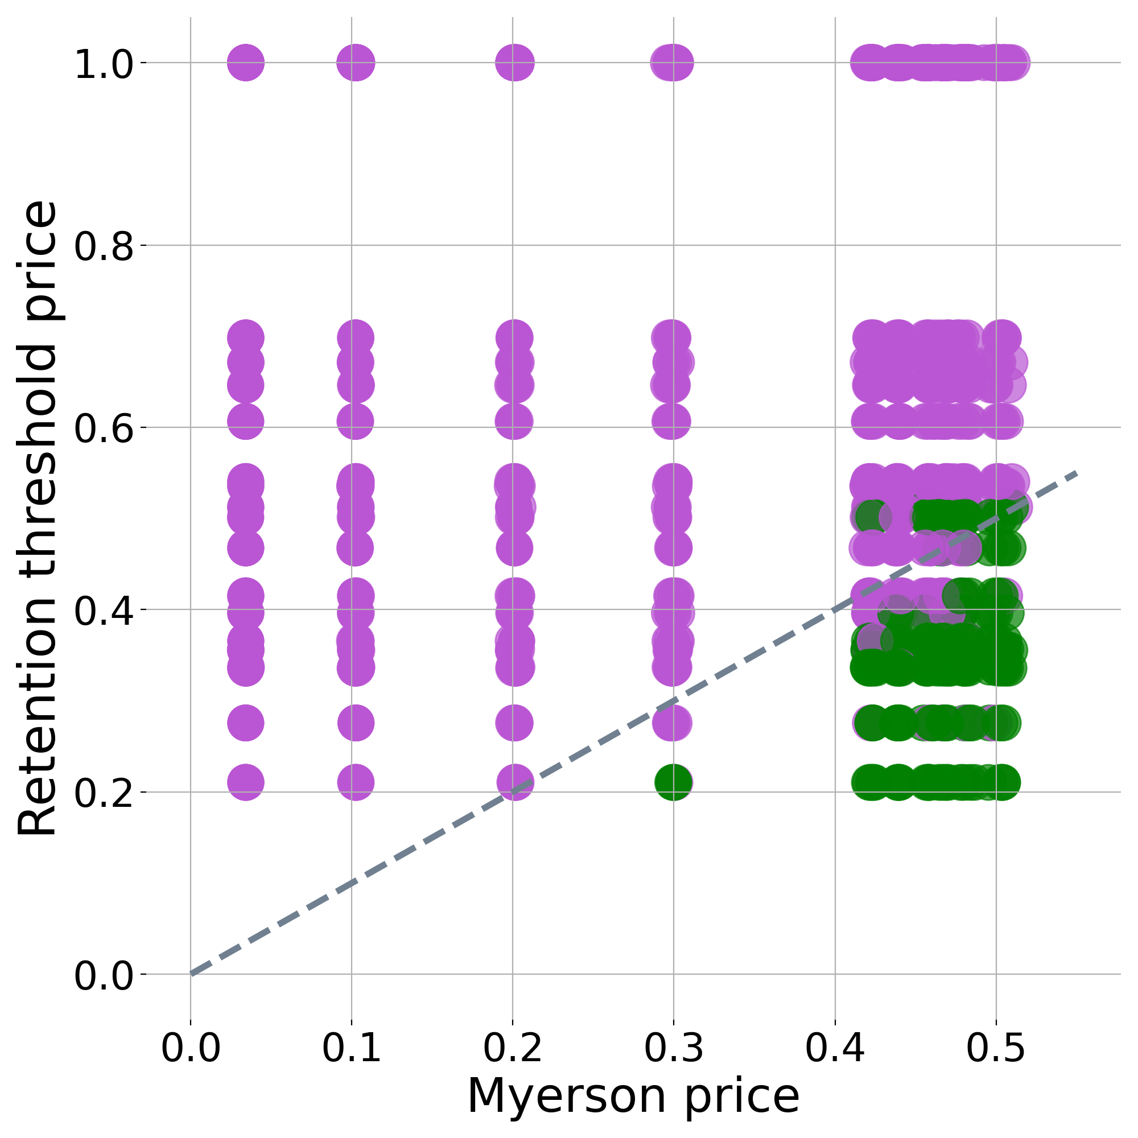
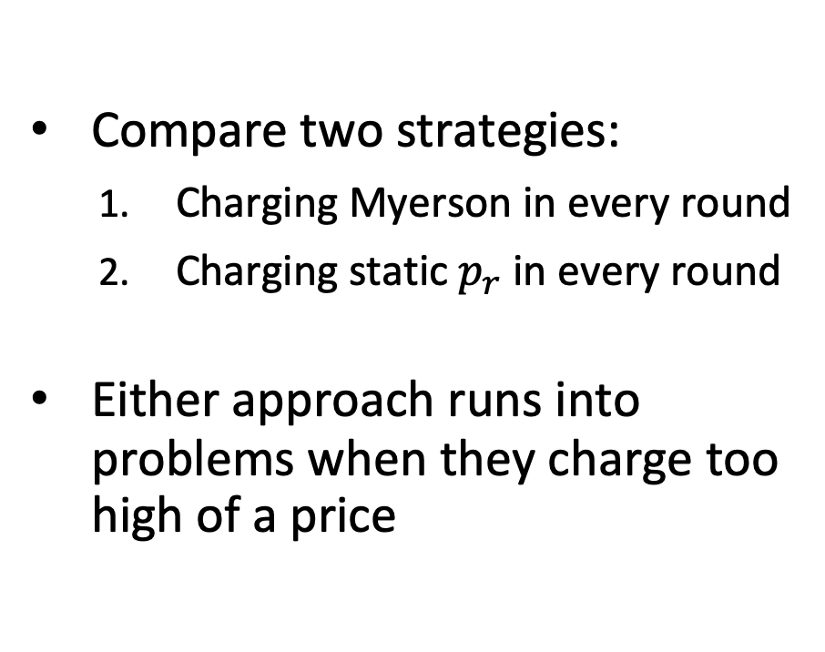

Performance of Components of MT Pricing
3 + MHR
Compare two strategies:
  Charging Myerson in every round
  Charging static $p_{r}$ in every round
Either approach runs into problems when they charge too high of a price
$$p_{r}$$

Slide 44
Performance of Components of MT Pricing
3 + MHR
Compare the two components:
  Charging Myerson in every round
  Charging static retention-based upper bound price in every round
Either approach runs into problems when they charge too high of a price
Unsurprisingly, adaptively picking the smaller price is usually better than the best performing alternative

Slide 45
Future Directions
This is only the tip of the iceberg in terms of microtransactions
  Generalizations of skips (battle-passes)
  Monetizing other player behavior (lives in Candy Crush)
Incorporating real data
  Explicitly model secondary effects (why are happy player-bases important?)
  Focus on real-world settings when evaluating performance

Slide 46
Simulations
Constant approximations are nice but how well does this thing do on “average”
You might worry the upper bound is saving you from some theoretical worst case but is not good on average
We simulate a variety of possible type, and retention distributions to better understand how much revenue MT pricing generates compared to some alternatives

Slide 47
Simulations Cont.
We look at two alternative pricing schemes:
  Charging Myerson
  Charging retention-based upper bound price
We see that of these two pricing schemes the optimal one is usually the one with the lower price
Unsurprisingly, the average performance of MT pricing is usually at least as good if not better than the best of these two alternative options

Slide 48
Future Directions
This is only the tip of the iceberg in terms of microtransactions
  Generalizations of skips (battle-passes)
  Monetizing other player behavior (lives in Candy Crush)
Incorporating real data
  Can better model secondary effects (why are happy player-bases important?)
  Focus better on realistic settings when evaluating performance

Slide 49

What Do We Know About These Games?
Design patterns from industry
Research by academics
Data describing player behavior
Notes:
Linear bullets
Make it more visual

Slide 50
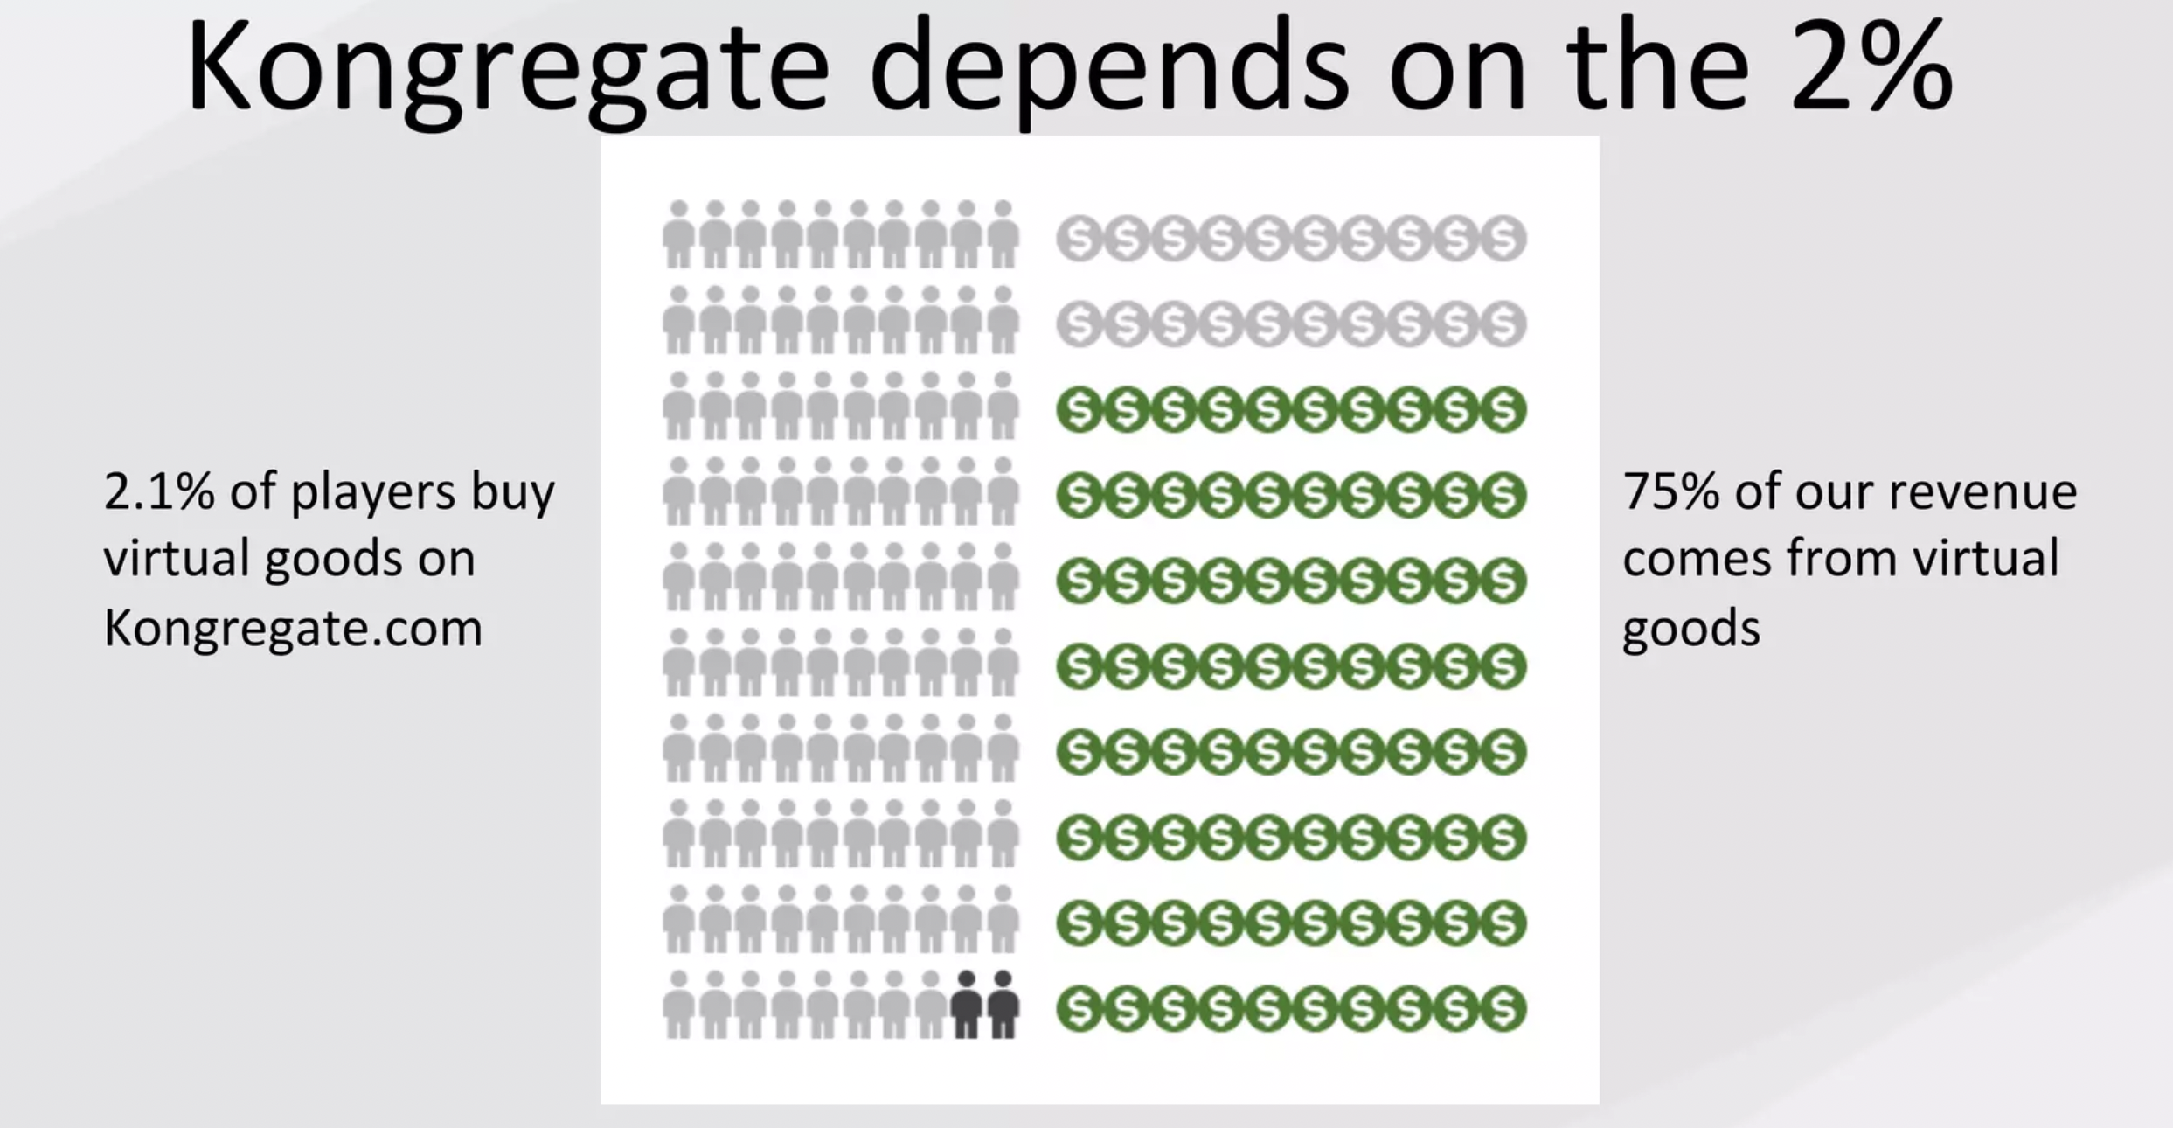
Evidence from Practice
Top Grossing Idle Games²
Average Revenue Per User | Average Revenue Per Paying User | Buyer Rate
$1.52 USD | $29.43 USD | 5.1%
$0.79 USD | $20.32 USD | 3.9%
$0.68 USD | $79.96 USD | 1.8%
$0.63 USD | $27.40 USD | 2.3%
$0.51 USD | $33.99 USD | 4.9%
2. https://blog.kongregate.com/the-rise-and-rise-of-idle-games/
Notes:
Now that I've set up the ingredients let me give you the flavor of result we look for. There is seemingly this paradox in the game design community where designers acknowledge that player happiness is the metric the optimize for and yet often we see that skips are prohibitively expensive. How can this make sense. Well the answer lies in something I said earlier. The game retains its value as long as some players are still legitimately completing the task. This leads to an interesting dynamic were the value of the game depends not only on the length of the task but also on the price set to skip it. Even with this ingredient we show that finding distributions of players which can support high prices isn’t easy. We need two things 1. A large portion of the player base who are never willing to buy skips. 2. Enough "whale" players who are willing to spend a lot of money in order to get ahead. What do you know this "whale" distribution is exactly what you would expect to see in a wide range of mobile games.

Slide 51
Something New is Going On
Free-to-Play easily compatible with standard economic models
  try-before-you-buy
  subscription models
  monetize through ads
But the kind of behaviors that are monetized
in modern mobile games are qualitatively different
  virtual items
  buying lives
  paying to avoid waiting
Notes:
Make paying to avoid waiting bold at the end

Slide 52


Why On Earth Would Anyone Buy a Skip?
Players value accomplishing tasks others can't [Lehdonvirta 2009]
Players are impatient
These impatience levels are heterogeneous across players
2
1 hr.
2
1 hr.
Notes:
social value should be emphasized
Be more explicit about the value in difficulty graph
Phrase it both ways.

Slide 53
What Do We Know About These Games?
Notes:
Linear bullets
Make it more visual

Slide 54
How do we solve the problem in the flat region
Looks a lot more like traditional mechanism design
But there is a tradeoff between revenue and utility
Model via retention

Slide 55
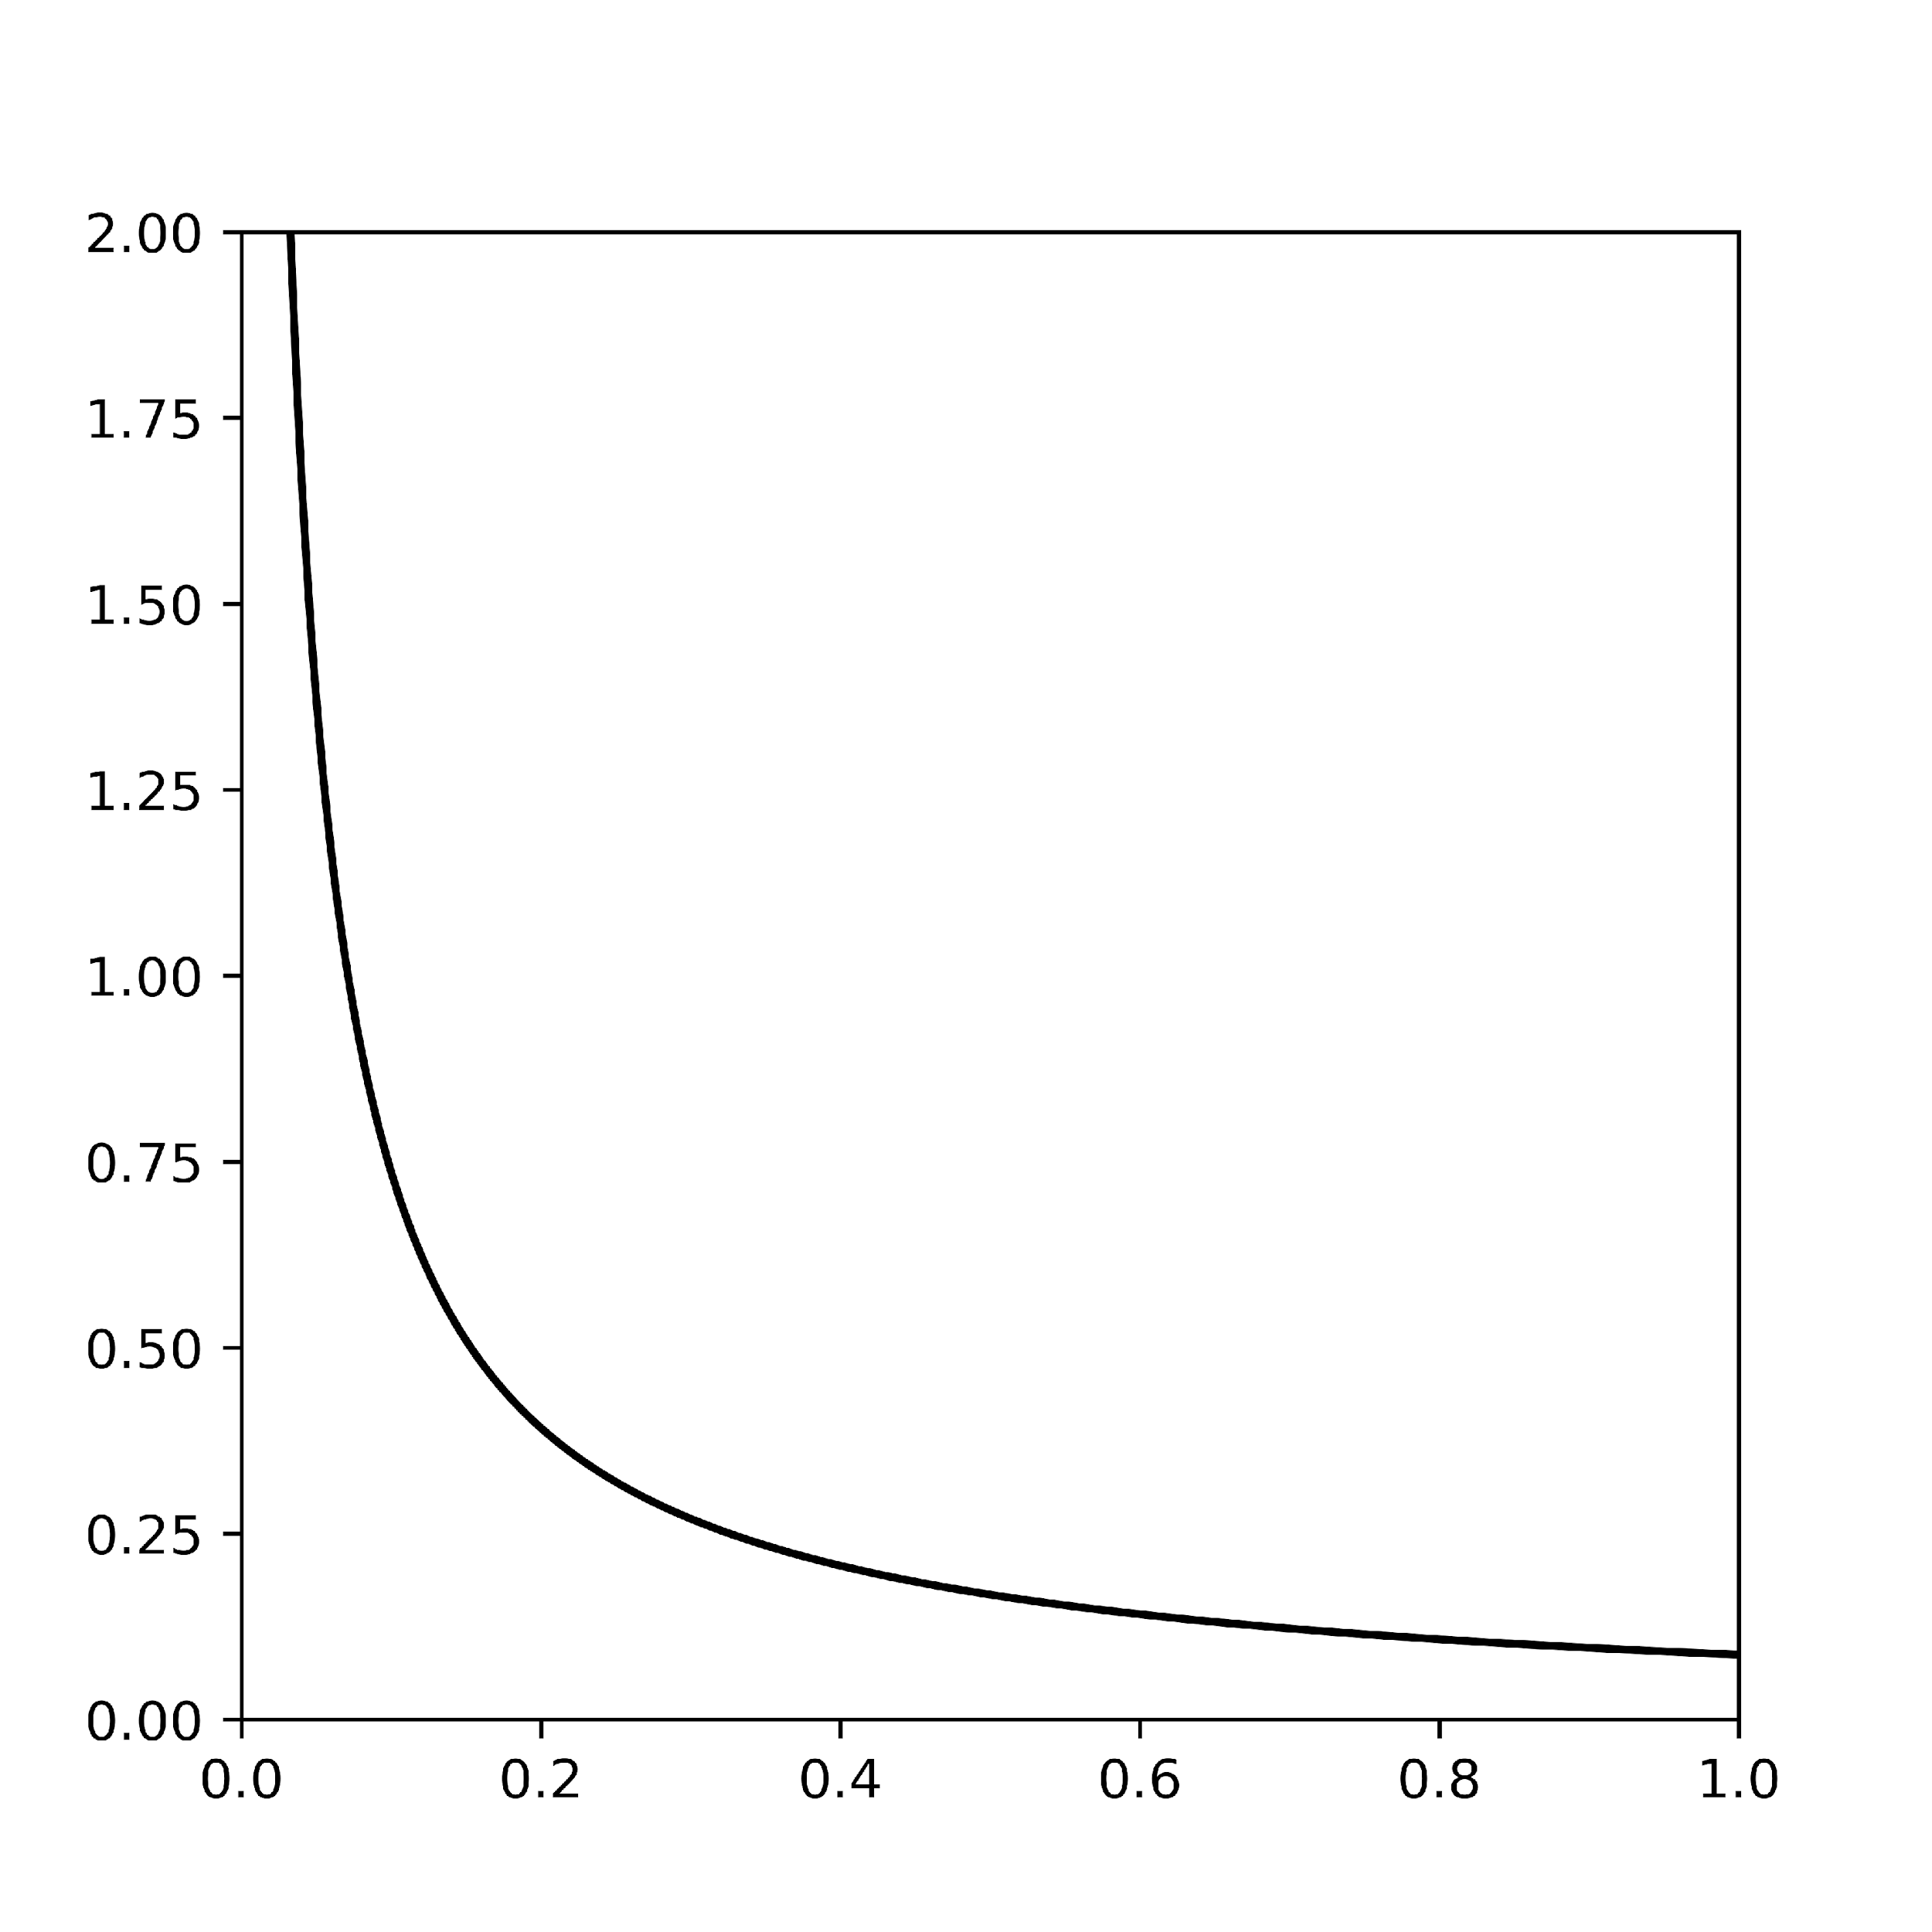
Evidence from Practice
Top Grossing Idle Games²
Average Revenue Per User | Average Revenue Per Paying User | Buyer Rate
$1.52 USD | $29.43 USD | 5.1%
$0.79 USD | $20.32 USD | 3.9%
$0.68 USD | $79.96 USD | 1.8%
$0.63 USD | $27.40 USD | 2.3%
$0.51 USD | $33.99 USD | 4.9%
density
impatience
2. https://blog.kongregate.com/the-rise-and-rise-of-idle-games/
Notes:
Now that I've set up the ingredients let me give you the flavor of result we look for. There is seemingly this paradox in the game design community where designers acknowledge that player happiness is the metric the optimize for and yet often we see that skips are prohibitively expensive. How can this make sense. Well the answer lies in something I said earlier. The game retains its value as long as some players are still legitimately completing the task. This leads to an interesting dynamic were the value of the game depends not only on the length of the task but also on the price set to skip it. Even with this ingredient we show that finding distributions of players which can support high prices isn’t easy. We need two things 1. A large portion of the player base who are never willing to buy skips. 2. Enough "whale" players who are willing to spend a lot of money in order to get ahead. What do you know this "whale" distribution is exactly what you would expect to see in a wide range of mobile games.

Slide 56
How much do players know about the distribution of impatience?
Notes:
This title needs to change or impatience distribution needs to be mentioned earlier

Slide 57
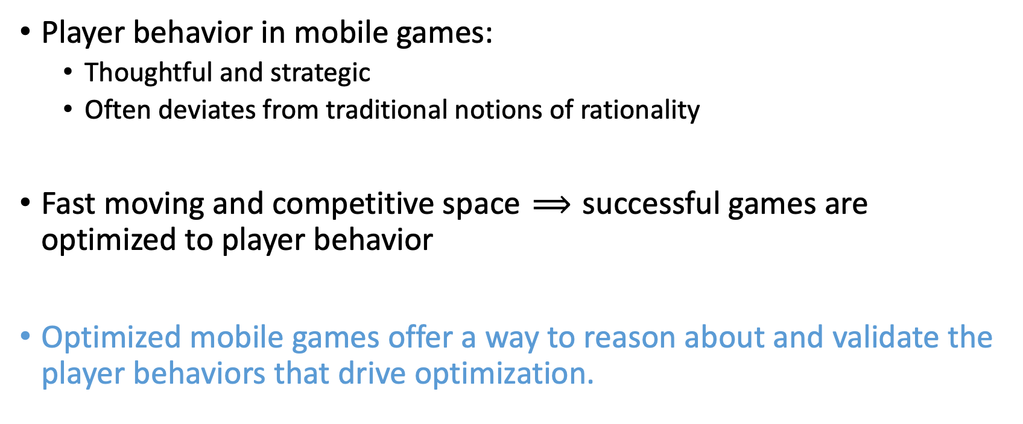
Mobile Games are a Playground for AGT
Notes:
Change to playground research topic.
Break first one into two parts.
Missing something about data.
Changing monetizations to more game design language.
Three prongs to draw from data, academics, industry.
More amibitous "why do you want to work in this area"

Slide 58


Skip Prices Affect Values in Two Ways
Players are trying to signal how dedicated they are to accomplishing tasks, not how much money is in their wallet
As skips become cheaper, it becomes the easier path for more players and the game looks more Pay to Win.
Notes:
Needs visuals.

Slide 59
Two Interesting Domains in AGT + Mobile Games
"Idle Games" (e.g., Cow Clicker)
  How can we explain why people play
  What are the implications for game optimization?
Forced breaks (e.g., Candy Crush)
  Why do these help games?
  Why are they structured as they are?

Slide 60
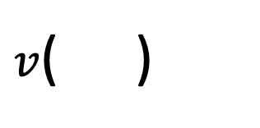
Skip Prices Affect Values
Impatient players want to receive the value of accomplishing a difficult task without waiting
But the price of a skip also affects the value of accomplishment
Notes:
social value should be emphasized
Be more explicit about the value in difficulty graph
Phrase it both ways.

Slide 61
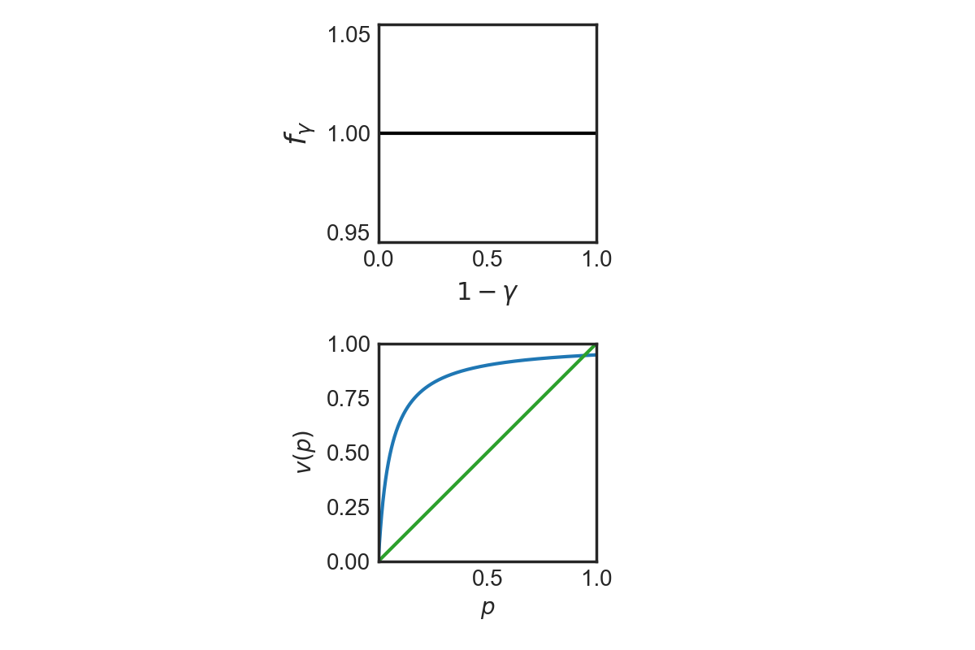
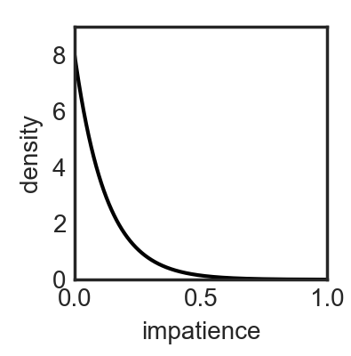
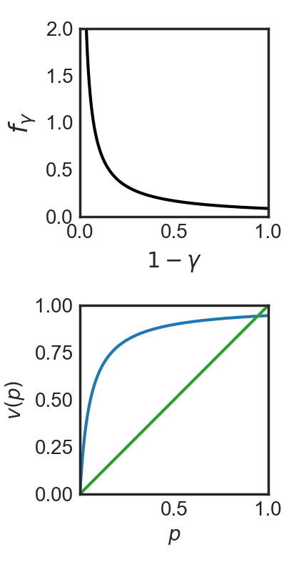
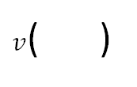
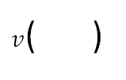

Game Optimization: Theory
density
density
density
Revenue Optimal Price
impatience
impatience
impatience
Utility Optimal Price
Notes:
Now that I've set up the ingredients let me give you the flavor of result we look for. There is seemingly this paradox in the game design community where designers acknowledge that player happiness is the metric the optimize for and yet often we see that skips are prohibitively expensive. How can this make sense. Well the answer lies in something I said earlier. The game retains its value as long as some players are still legitimately completing the task. This leads to an interesting dynamic were the value of the game depends not only on the length of the task but also on the price set to skip it. Even with this ingredient we show that finding distributions of players which can support high prices isn’t easy. We need two things 1. A large portion of the player base who are never willing to buy skips. 2. Enough "whale" players who are willing to spend a lot of money in order to get ahead. What do you know this "whale" distribution is exactly what you would expect to see in a wide range of mobile games.
Willingness to pay for skip instead of impatience
Animate the graphs step by step

Slide 62
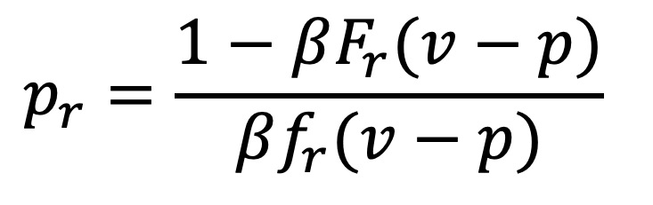
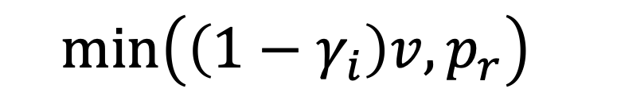
Insight from a More Powerful Game Designer
If a game designer had complete knowledge over every players’ type, they would:
Compute a static upper bound based on the retention distribution
2. Charge the minimum of a player’s marginal value and the retention upper bound price.
$$p_{r}=\frac{1−βF_{r}(v−p)}{βf_{r}(v−p)}$$
$$m\text{in}\left(\left(1−γ_{i}\right)v, p_{r}\right)$$
Notes:
Insert upper bound from the paper on this slide
Insert Min(marginal value, Upper Bound)

Slide 63
Complete Information upper bound

