Slide 1

What Counts as Evidence that a Model is “Trustworthy”
Narun K. Raman
University of British Columbia
Joint work with Taylor Lundy and Kevin Leyton-Brown

Slide 2
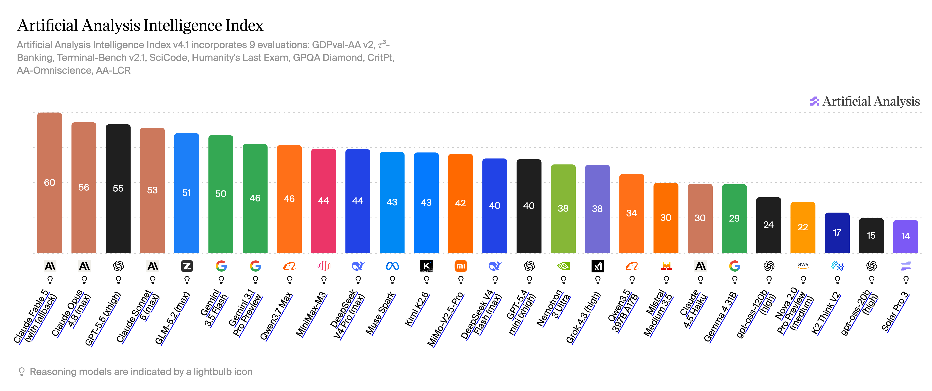
A common paradigm is average performance

Slide 3
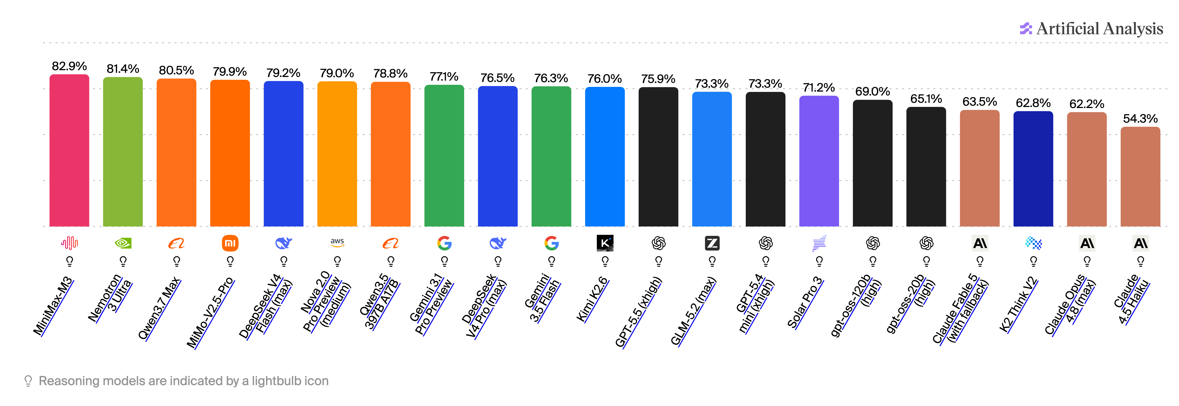
Averages can hide failures that matter
High average performance is fully compatible with a pocket of inputs where the model fails every time
For example, Fable 5 goes from the best performing model on average to 18th on IFBench. A 20pp drop from 1st!

Slide 4
Trust needs scoped guarantees
Where the model fails,
  e.g., on medical domains,
  smoothing consumption,
  etc.
how badly and with what certainty, and
  Give confidence bounds on the failure rate
what remains unresolved
  Where have we sampled enough to certify
  and where have we not?
Fig. 1: High average performance with clear region of low trust

Slide 5
The hard part is spending samples well
1,995 benchmark papers submitted to NeurIPS in 2025 alone!
These benchmarks are often so large that high precision everywhere is too expensive; one or two samples per region is not enough
In an ideal world we run an adaptive algorithm that samples promising regions, certifies when its certain, and then moves on to the next frontier

Slide 6
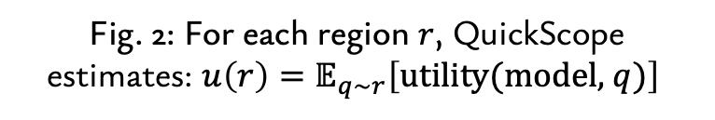
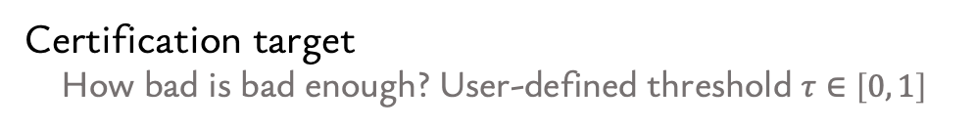
QuickScope turns question families into estimates
Treat each question family as an arm in a multi-armed bandit to estimate its failure rate
❥
Regions in question space
Which questions are comparable? Categories in
a static benchmark or a generator in a dynamic one.
Physics questions
❥
Failure signal
What do we measure on each question? User-defined,
could be error rate, complexity-weighted error, etc.
q ~ gen(a, b)
❥
Certification target
How bad is bad enough? User-defined threshold $τ∈\left[0, 1\right]$
Fig. 2: For each region $r$, QuickScope estimates: $u\left(r\right)=𝔼_{q\sim r}\left[\text{utility}\text{(}\text{model}\text{, }q)\right]$
Notes:
That's the problem QuickScope solves — agnostic to static or dynamic. You hand it a benchmark and a utility function: your definition of interesting — raw error rate, or error that's surprisingly high given a question's measured complexity. It runs an adaptive, bandit-style search over the question space. But the key design choice: it doesn't just FIND bad regions, it CERTIFIES them. It concentrates samples until it can make a high-confidence statement that error genuinely exceeds a threshold — once a region's lower confidence bound clears the threshold it's certified and removed, freeing budget. So the output isn't 'some questions the model got wrong.' It's a guarantee — with confidence one-minus-delta, error on this family is at least tau. A worst-case-shaped statement. The same shape as the claim trust requires. [2:00–3:15]

Slide 7

Sample, bound, certify, move on
Sample questions from active regions, evaluate the model and
update 𝑢(𝑟) and confidence bounds [LCB_{r}, UCB_{r}].
Certify region when LCB_{r} is above $τ$,
remove it from the active set, and move to new regions.
$$τ$$
Efficiency comes from stopping early:
certified and unpromising regions stop consuming budget.
Notes:
That's the problem QuickScope solves — agnostic to static or dynamic. You hand it a benchmark and a utility function: your definition of interesting — raw error rate, or error that's surprisingly high given a question's measured complexity. It runs an adaptive, bandit-style search over the question space. But the key design choice: it doesn't just FIND bad regions, it CERTIFIES them. It concentrates samples until it can make a high-confidence statement that error genuinely exceeds a threshold — once a region's lower confidence bound clears the threshold it's certified and removed, freeing budget. So the output isn't 'some questions the model got wrong.' It's a guarantee — with confidence one-minus-delta, error on this family is at least tau. A worst-case-shaped statement. The same shape as the claim trust requires. [2:00–3:15]

Slide 8
Same budget, more reliable weak spots
Even QuickScope’s weakest top-k were
often harder than uniform’s average
Fig. 3: GPT-5 mini evaluated on 2 benchmarks via three methods each with 20,000 requests:
uniform sampling, QuickScope with certification at 0.9, and QuickScope with no certification
Notes:
And it works. Three dynamic benchmarks, 20,000-call budgets, and — crucially — we re-evaluate every method's top picks with at least 200 fresh samples to check whether 'hard' was real. On DyVal and Grid Reasoning, QuickScope's top-10 come back above 99% error on re-evaluation; uniform sampling's picks average below 98% — and its ranking is padded with false positives: questions that looked hard in a small sample and regressed on re-test. In fact QuickScope's WORST top-K pick tends to beat uniform's AVERAGE. The certificates are real statistics: all 100 top configurations' re-evaluated means landed inside their original confidence intervals. And certification is doing useful work: it trades a little precision at the top — already-known-hard configs — for 20% tighter bounds across ranks 11 to 100. Here's what a certificate looks like concretely: on DyVal, deep narrow arithmetic — depth-10, two-children chains — certified at 95%+ error. Not an anecdote: a region. So, good news: we can go beyond the average and produce genuine guarantees about where models fail. Now the bad news.

Slide 9
What you find depends on the failure signal
Fig. 4: GPT-5 mini evaluated on DyVal over two different utility functions: complexity-weighted error and error rate

Slide 10
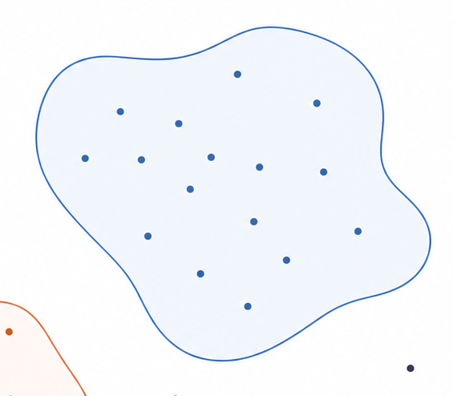

QuickScope is only as trustworthy as the measure
QuickScope guarantees the measured score in each region.
The certificate matters only if the score tracks the capability we care about.
These can diverge…
Scoring method A
Capability we don’t
Capability we care about
Scoring method B

Slide 11
The question can often be gamed
Reasoning Models are Test Exploiters [Raman et al. 2026]
Multiple-Choice Question (MCQA)
Free-Text Question (FTQA)
FTQA boosted by random guessing

Slide 12
The question can often be gamed
Reasoning Models are Test Exploiters [Raman et al. 2026]
Multiple-Choice Question (MCQA)
Free-Text Question (FTQA)
FTQA boosted by random guessing

Slide 13
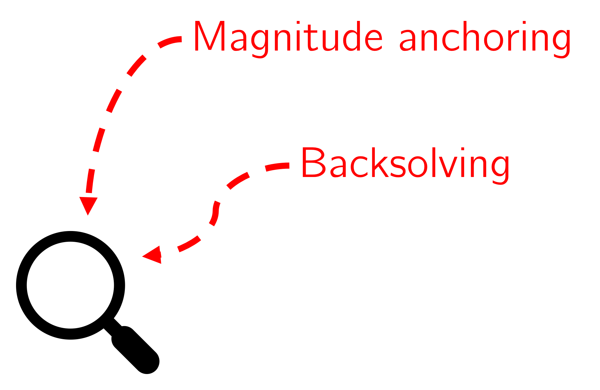
The question can often be gamed
Reasoning Models are Test Exploiters [Raman et al. 2026]
Multiple-Choice Question (MCQA)
Free-Text Question (FTQA)
FTQA boosted by random guessing
If MCQA > (FTQA + guessing), models are gaming the options

Slide 14
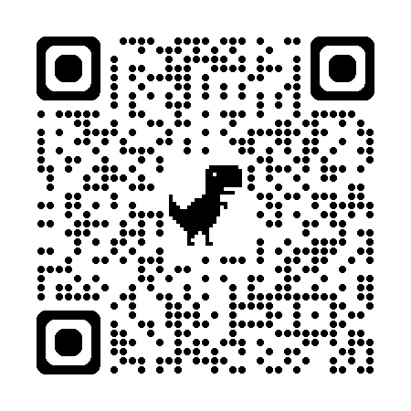
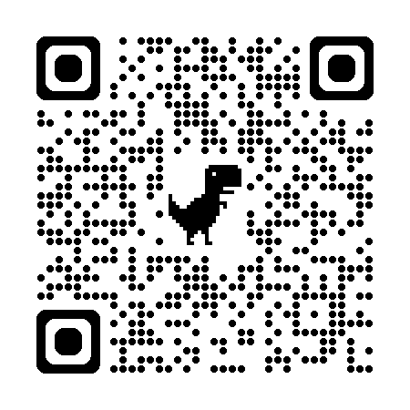
Takeaways
QuickScope
Test Exploiters
Look beyond the average; models fail in regions
Certify these regional failures through statistical guarantees
Validate the measurement channel. A certificate is only useful
when the score reveals the capability we care about
1
2
3
Trust means knowing where a model works, where it fails, and what your evidence actually measures.
Notes:
The main message is that evaluation should move from aggregate scores to region-level evidence. QuickScope gives us a way to do that efficiently: search large benchmark spaces, certify hard regions, and move on. But the guarantee is only as meaningful as the measurement channel. If the score reflects presentation effects or format exploitation, then the certified regions may not be the capability failures we actually care about. So what counts as evidence is not just a high score — it is a localized, statistically supported, well-measured claim about model behavior.

